Slide 1
Managing Mobility, Emissions & Air Quality in City of Santa Monica
08.29.2019

Slide 2
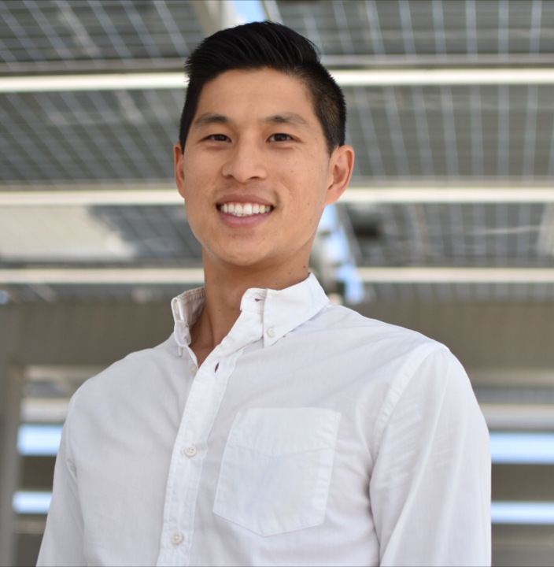
Garrett Wong Climate Program Manager County of Santa Barbara Aug 26, 2019 – current Sr. Sustainability Analyst City of Santa Monica 2012-2019

Slide 3
About Santa Monica
8.3 square miles
Population: ~92,000 Daytime: ~250- 300,000
Major industries: Entertainment, Tourism, Technology, Health, Retail
Los Angeles
County
Los Angeles
City
City of
Santa Monica

Slide 5
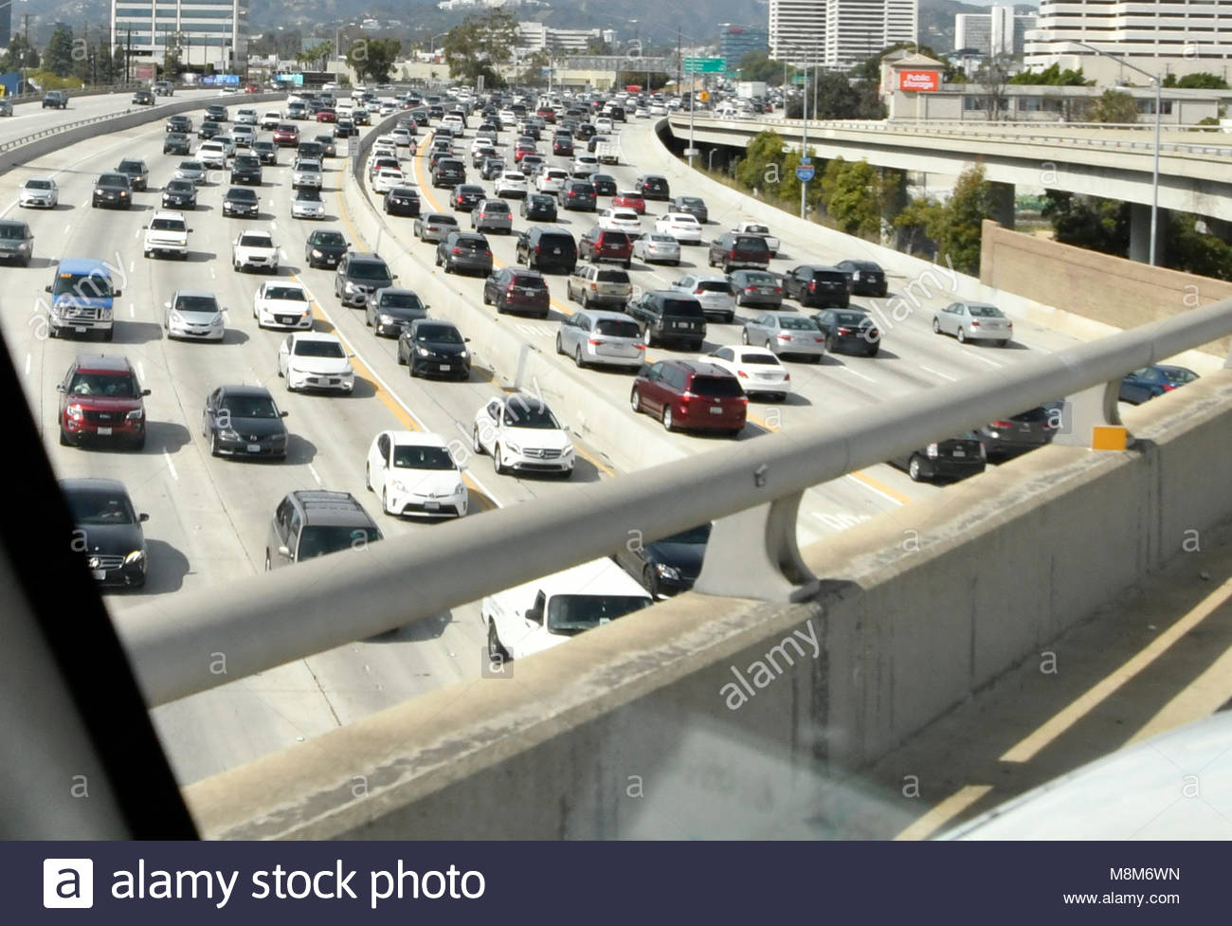

Slide 8
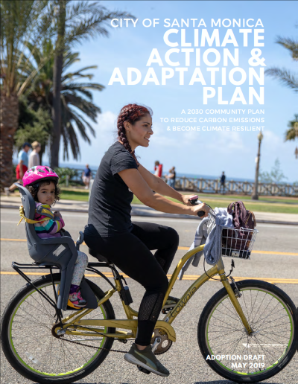
Getting to Carbon Neutrality
80% below 1990 levels by 2030

Slide 9
Where do Santa Monica’s greenhouse gases
come from?
Aviation ^{Waste}
SECTOR | SOURCE
Residential | Annual Electricity Use
 | Annual Natural Gas Use
Commercial | Annual Electricity Use
 | Annual Natural Gas Use
Industrial | Annual Electricity Use
 | Annual Natural Gas Use
Waste | Landfilled Waste
Transportation | Vehicle Miles Traveled (modeled)
 | Regional Vehicle Mix (modeled)
Aviation | Aviation Fuel
2%
3%
Residential 12%
Commercial 14%
Industrial 5%
Vehicle Transportation 64%
Emissions by Source (2015)

Slide 10
Climate Actions
Emissions by Source
Vehicle Fuel - Gasoline
Building Electricity Use
Mobility: Bike, Walk, Transit, etc Electric Vehicles
Building Natural Gas Use
Vehicle Fuel - Diesel
0
200,000
400,000
600,000

Slide 11
Sustainable Mobility Strategies
Increase low and zero carbon mobility options
Increase road safety for all
Transition vehicles to electric or zero emission

Slide 12
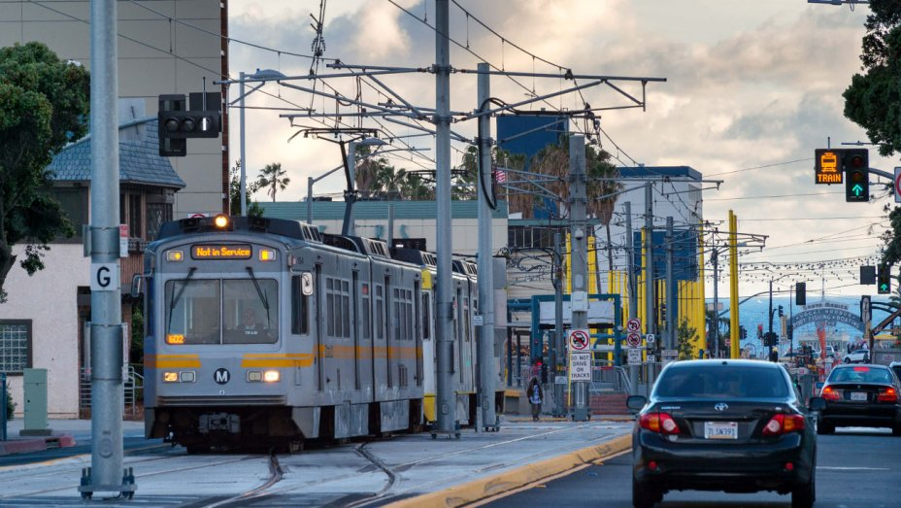
Increase low & zero carbon mobility options

Slide 13
Increase low & zero carbon mobility options

Slide 14
Increase road safety for all

Slide 15
Transition vehicles to electric or zero emission

Slide 16
-1.2%

Slide 17
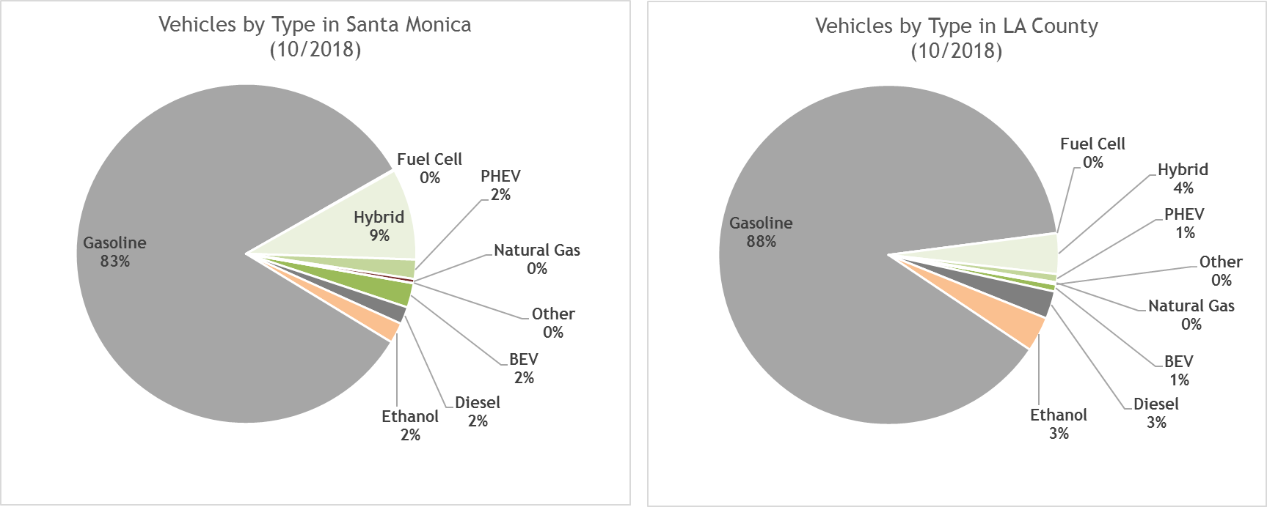
Registered Vehicles by Type

Slide 19
City Fleet Fuel Consumption (2014-2018)

Slide 20
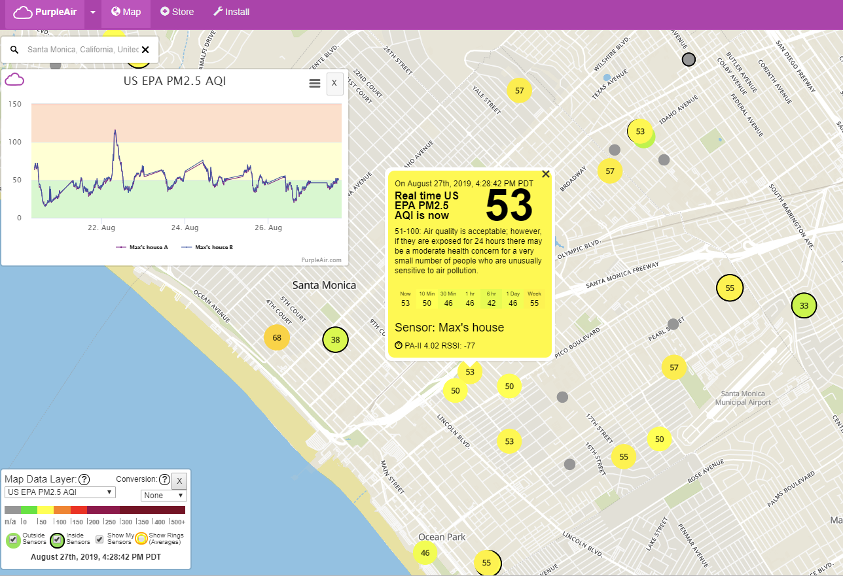
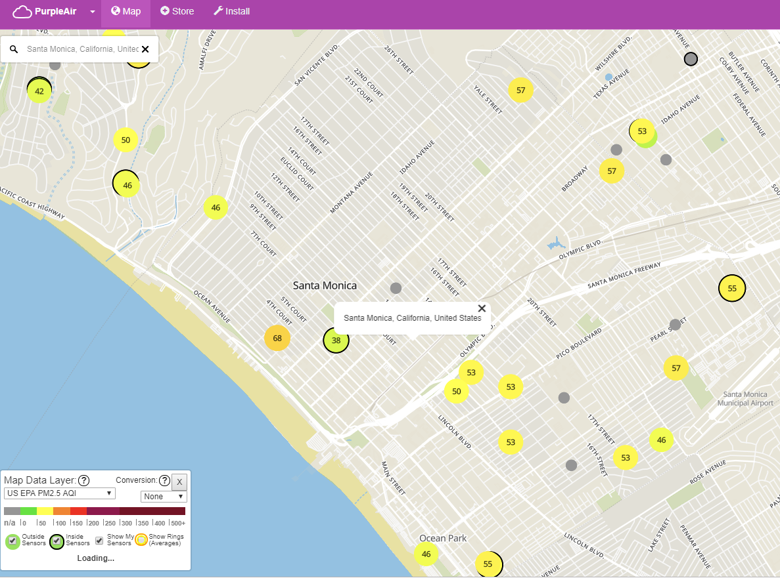
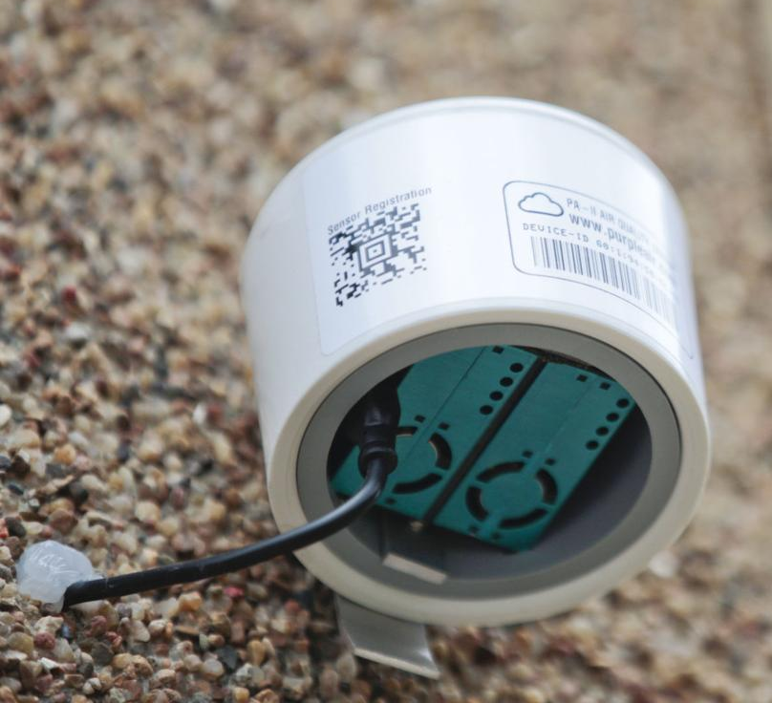
Monitoring
Local Air
Quality

Slide 21
Climate Action & Adaptation Plan
Zero Waste
Sustainable Mobility
Zero Net Carbon Buildings
Land Use & Circulation Element
Transit – Light Rail & Bus Programs
Resilient Energy Action Plan
Sustainable Energy Master Plan
Zero Waste Strategic Operations Plan
Bike Action Plan
Pedestrian Action Plan
EV Action Plan
Vision
Zero
Community Choice Energy
Existing Building Policies
Adopted
Planned

Slide 22
Thank You!
www.sustainablesm.org
gwong@co.santa-barbara.ca.us

