Slide 1
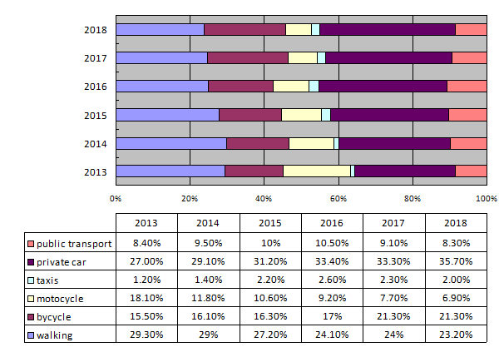
FOSHAN EXPERIENCE—Challenges
The Change of Travel Mode Structure in Recent Years

Slide 2
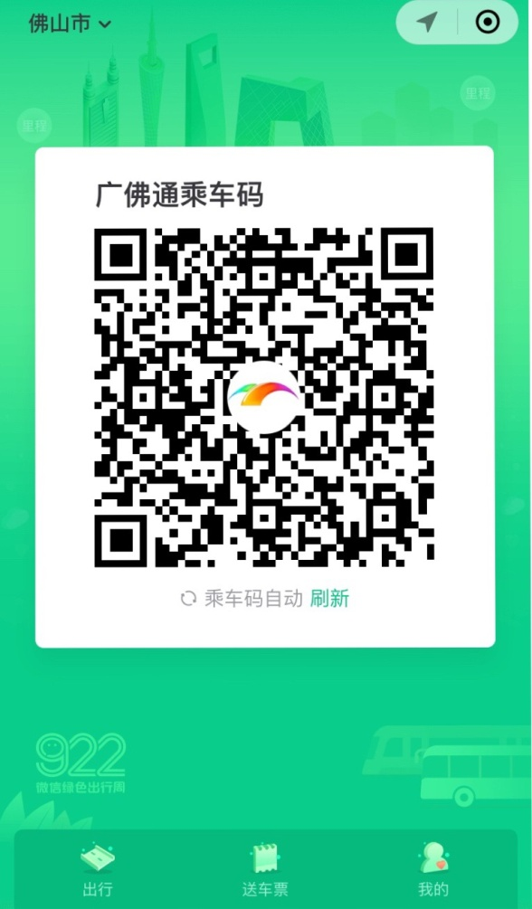
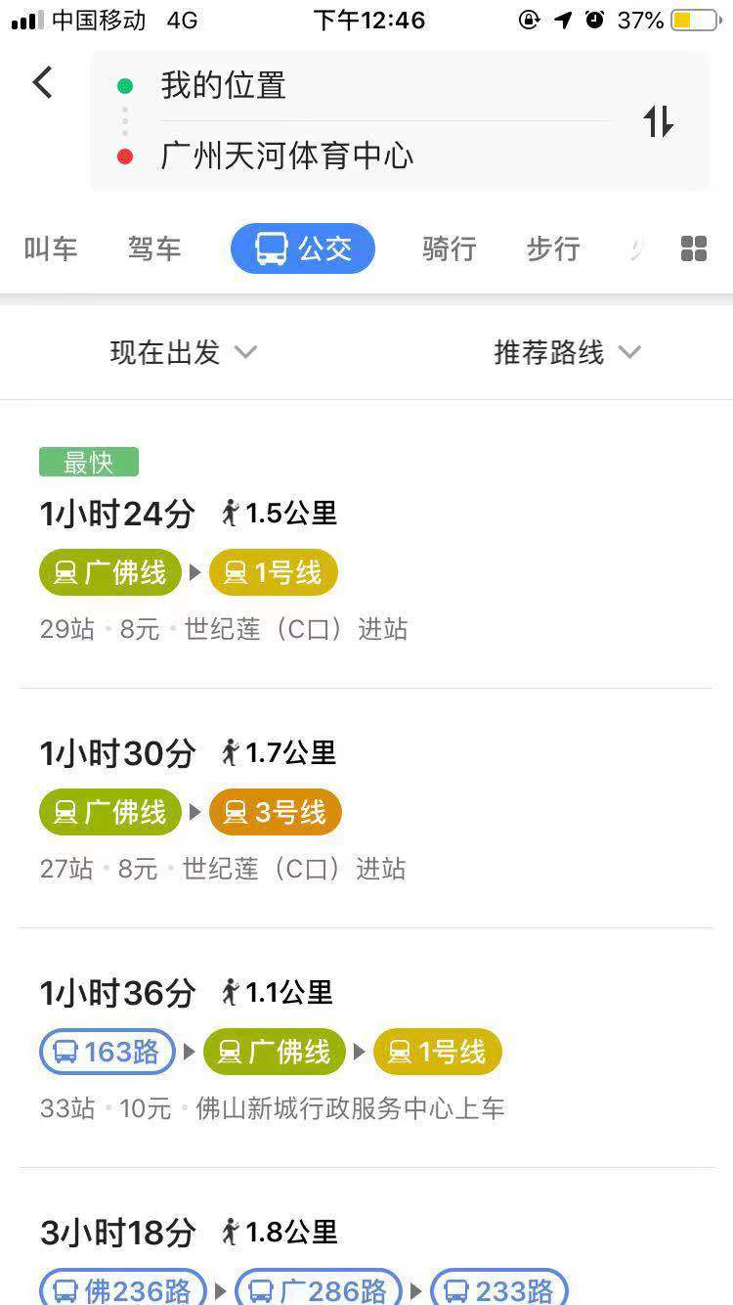
FOSHAN EXPERIENCE—Achievements and Goals
Shifting Payment with quick code
A map app combined with traveling info, taxi calling and shared bike renting

