Slide 1
City of Boulder
Colorado, USA
Cities Roundtable &
Role of Cities in Mobility Disruption
EcoMobility - Autonomy
October 16-17, 2019
Notes:
Name is …
Acknowledge team

Slide 2
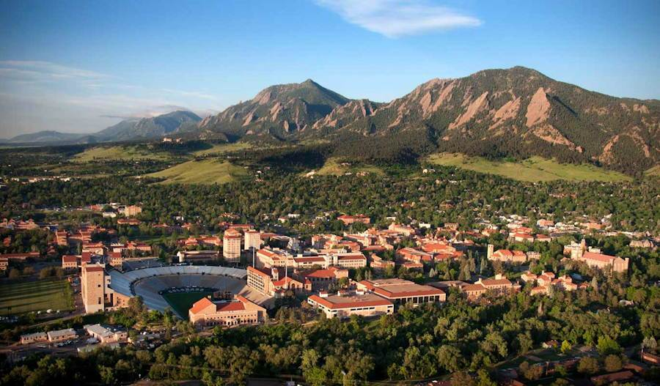
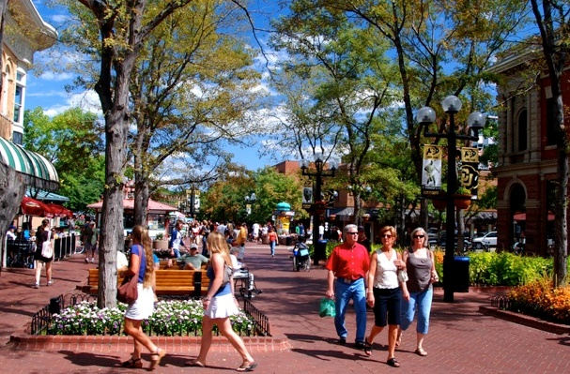
Boulder, Colorado
Eastern Foothills of the Rocky Mountains
70 sq. km
185 sq. km of Open Space
107,000 residents
104,000 jobs
University of Colorado and Federal Labs
Notes:
Alternate slides
27 square miles is 70 square kilometers
71 square miles is 185 square kilometers
Could eliminate the 40 res 60 non- res and just say that. Point is that most of the jobs are held by non-residents which leads to our in-commute challenges

Slide 3
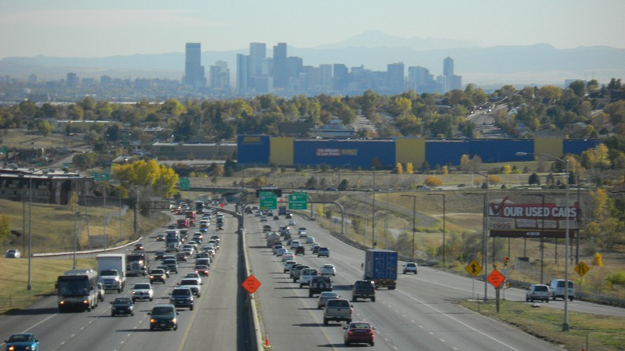

Colorado’s Climate Goals
Reduce GhG below 2005 levels:
  26% by 2025
  50% by 2030
  90% by 2050
ZEV standard for auto dealers

Slide 5
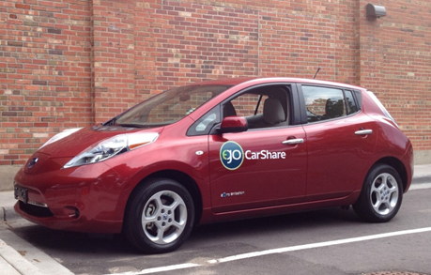
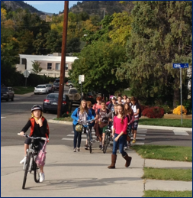
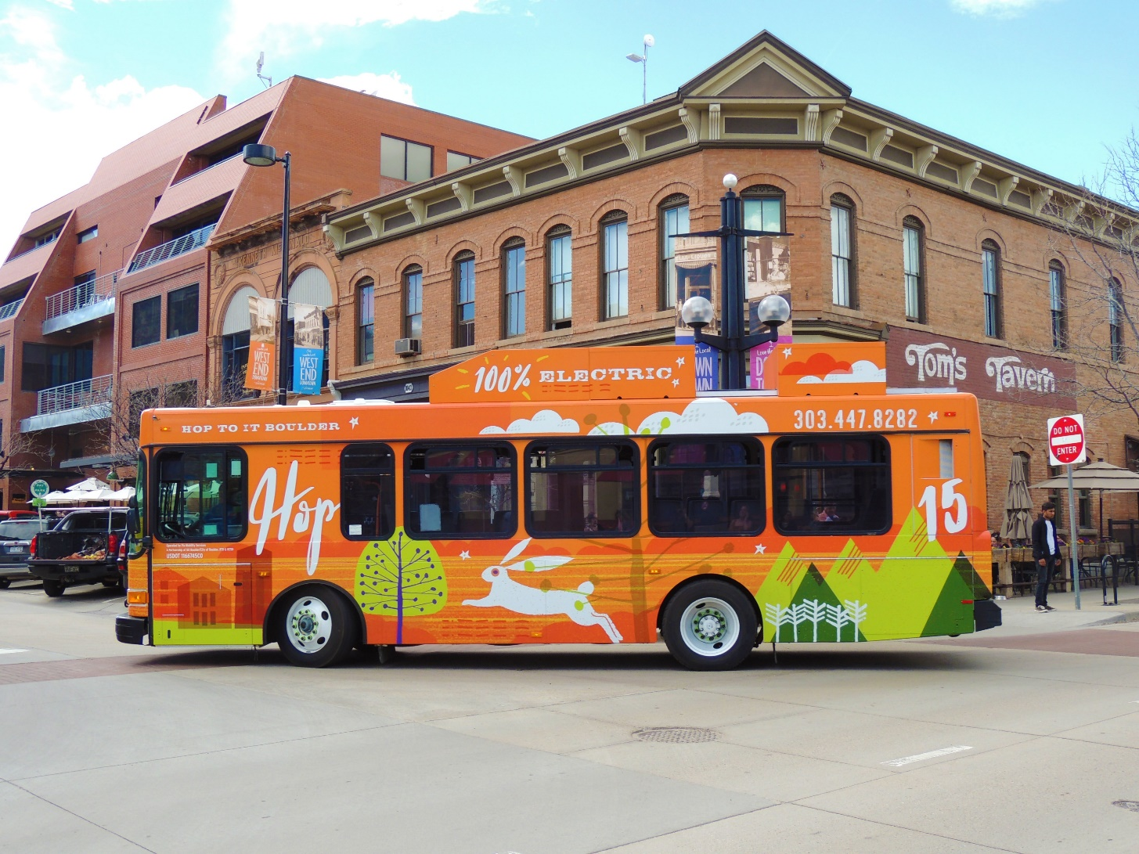
Climate Mobilization Action Plan
Declaration of Climate Crisis
28% of GHG emissions from ground transportation
Increase walk, bike, transit, micro-mobility options
Expand Electric Vehicles
Notes:
Kathleen, on this slide I would just add sub-bullets to the notes to reduce the words on the slide.
Boulder City Council adopted a resolution supporting the international climate crisis and committing to creating a new Climate Mobilization Action Plan that addresses many areas of focus, including energy and mobility
Boulder is leading at the local level and by adopting this declaration, the City of Boulder joins a global coalition of governments and leaders who officially acknowledge the existence of a global climate emergency and recognize the importance of local action to protect and enhance the well-being of current and future generations.
“Climate change has truly reached the level of being an emergency, and we need to move forward in taking action faster than ever, in a way that is broad-reaching, replicable and inclusive,” said Mayor Suzanne Jones. “Boulder has made great progress in working toward climate solutions, but this declaration will further add urgency to bringing the community together to mitigate and adapt to climate change.”
The resolution commits the city to climate mobilization action that immediately prioritizes efforts to safely draw down carbon from the atmosphere and accelerate adaptation and resilience strategies in preparation for intensifying climate impacts.
This comes on the heels of a renewed commitment to accelerating climate action through the city’s Climate Mobilization Action
Reduce GHG emissions
City 80% by 2030
Community 80% by 2050
100% Renewable Energy by 2030

Slide 6
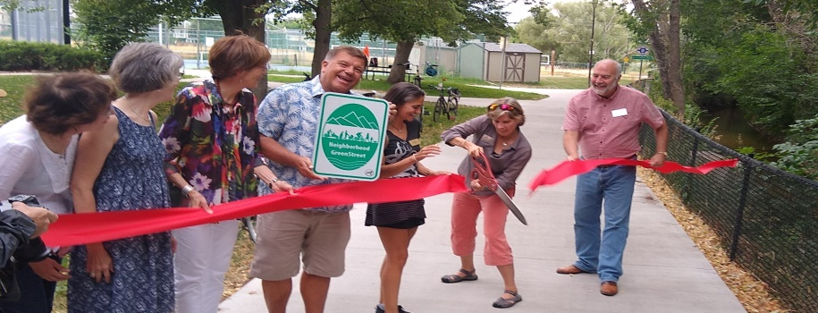
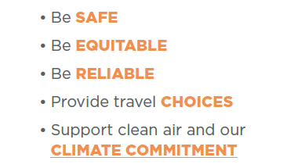
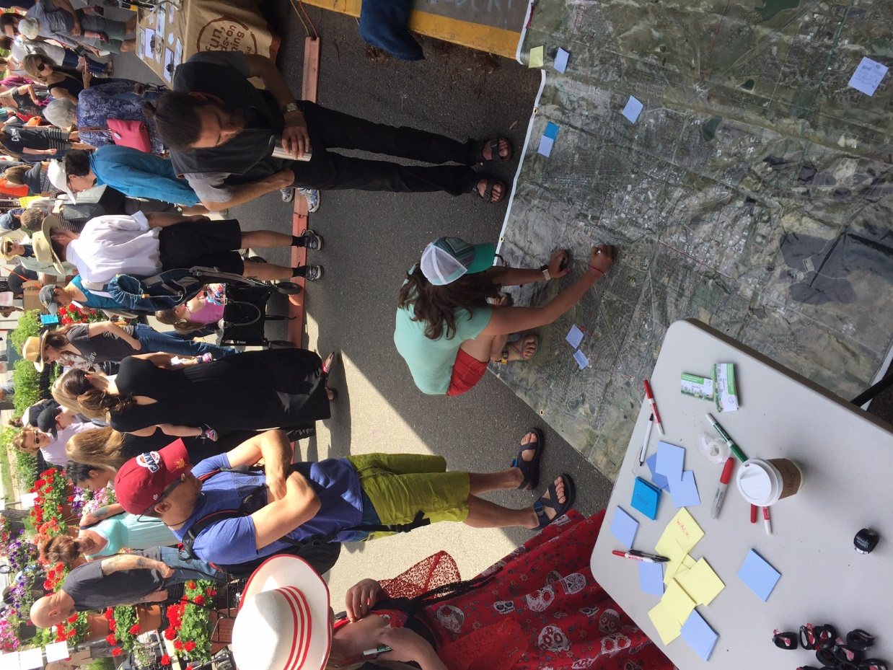
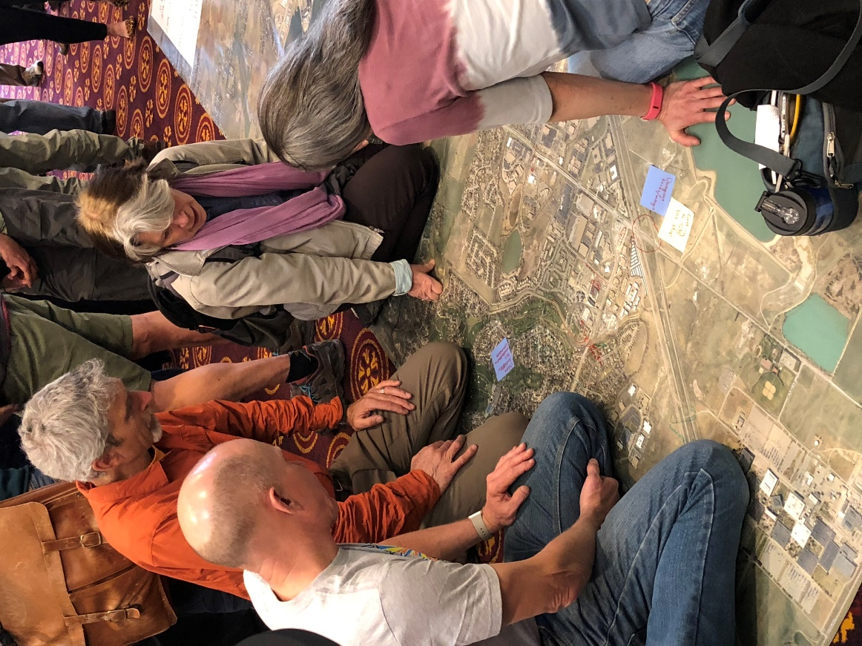
Boulder’s Transportation Vision
A safe, accessible and sustainable multi-modal transportation system that connects people with each other and where they want to go…
Notes:
Since 2014 plan have a longer Vision statement, part here, saying we want a safe, accessible and sustainable transportation system
TAB member provide the summary bullets of what this means.

Slide 7
Boulder Mode Share
Today & 2030
Mode Split | 2017/18* |  | 2030
 | Residents (all trips) | Non-Residents (work trips) | Residents | Non-Residents (work trips)
Walk | 20% | 0% | 25% | 0%
Bike | 17% | 2% | 30% | 2%
Transit | 5% | 8% | 10% | 12%
Single Occupant Vehicle | 37% | 77% | 20% | 60%
Multi Occupant Vehicle | 21% | 6% | 15% | 25%
Source: City of Boulder Resident Travel Diary (2018) and Boulder Valley Employee Survey (2017)

Slide 8

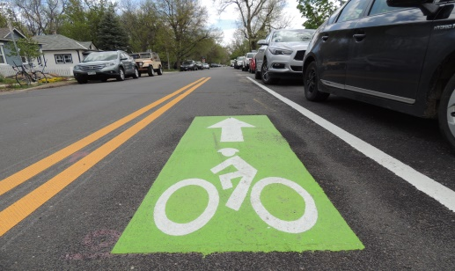
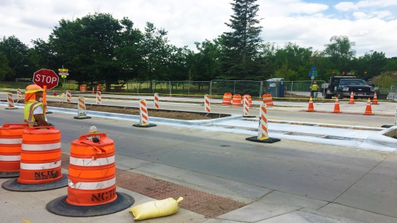
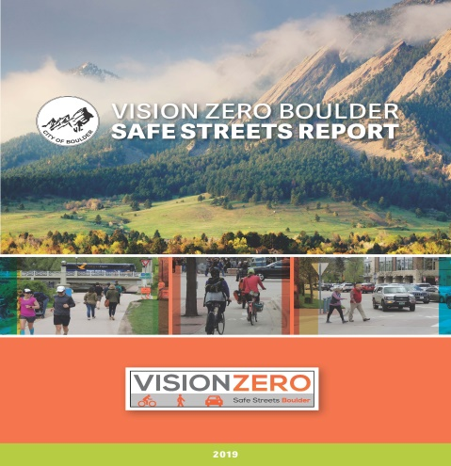

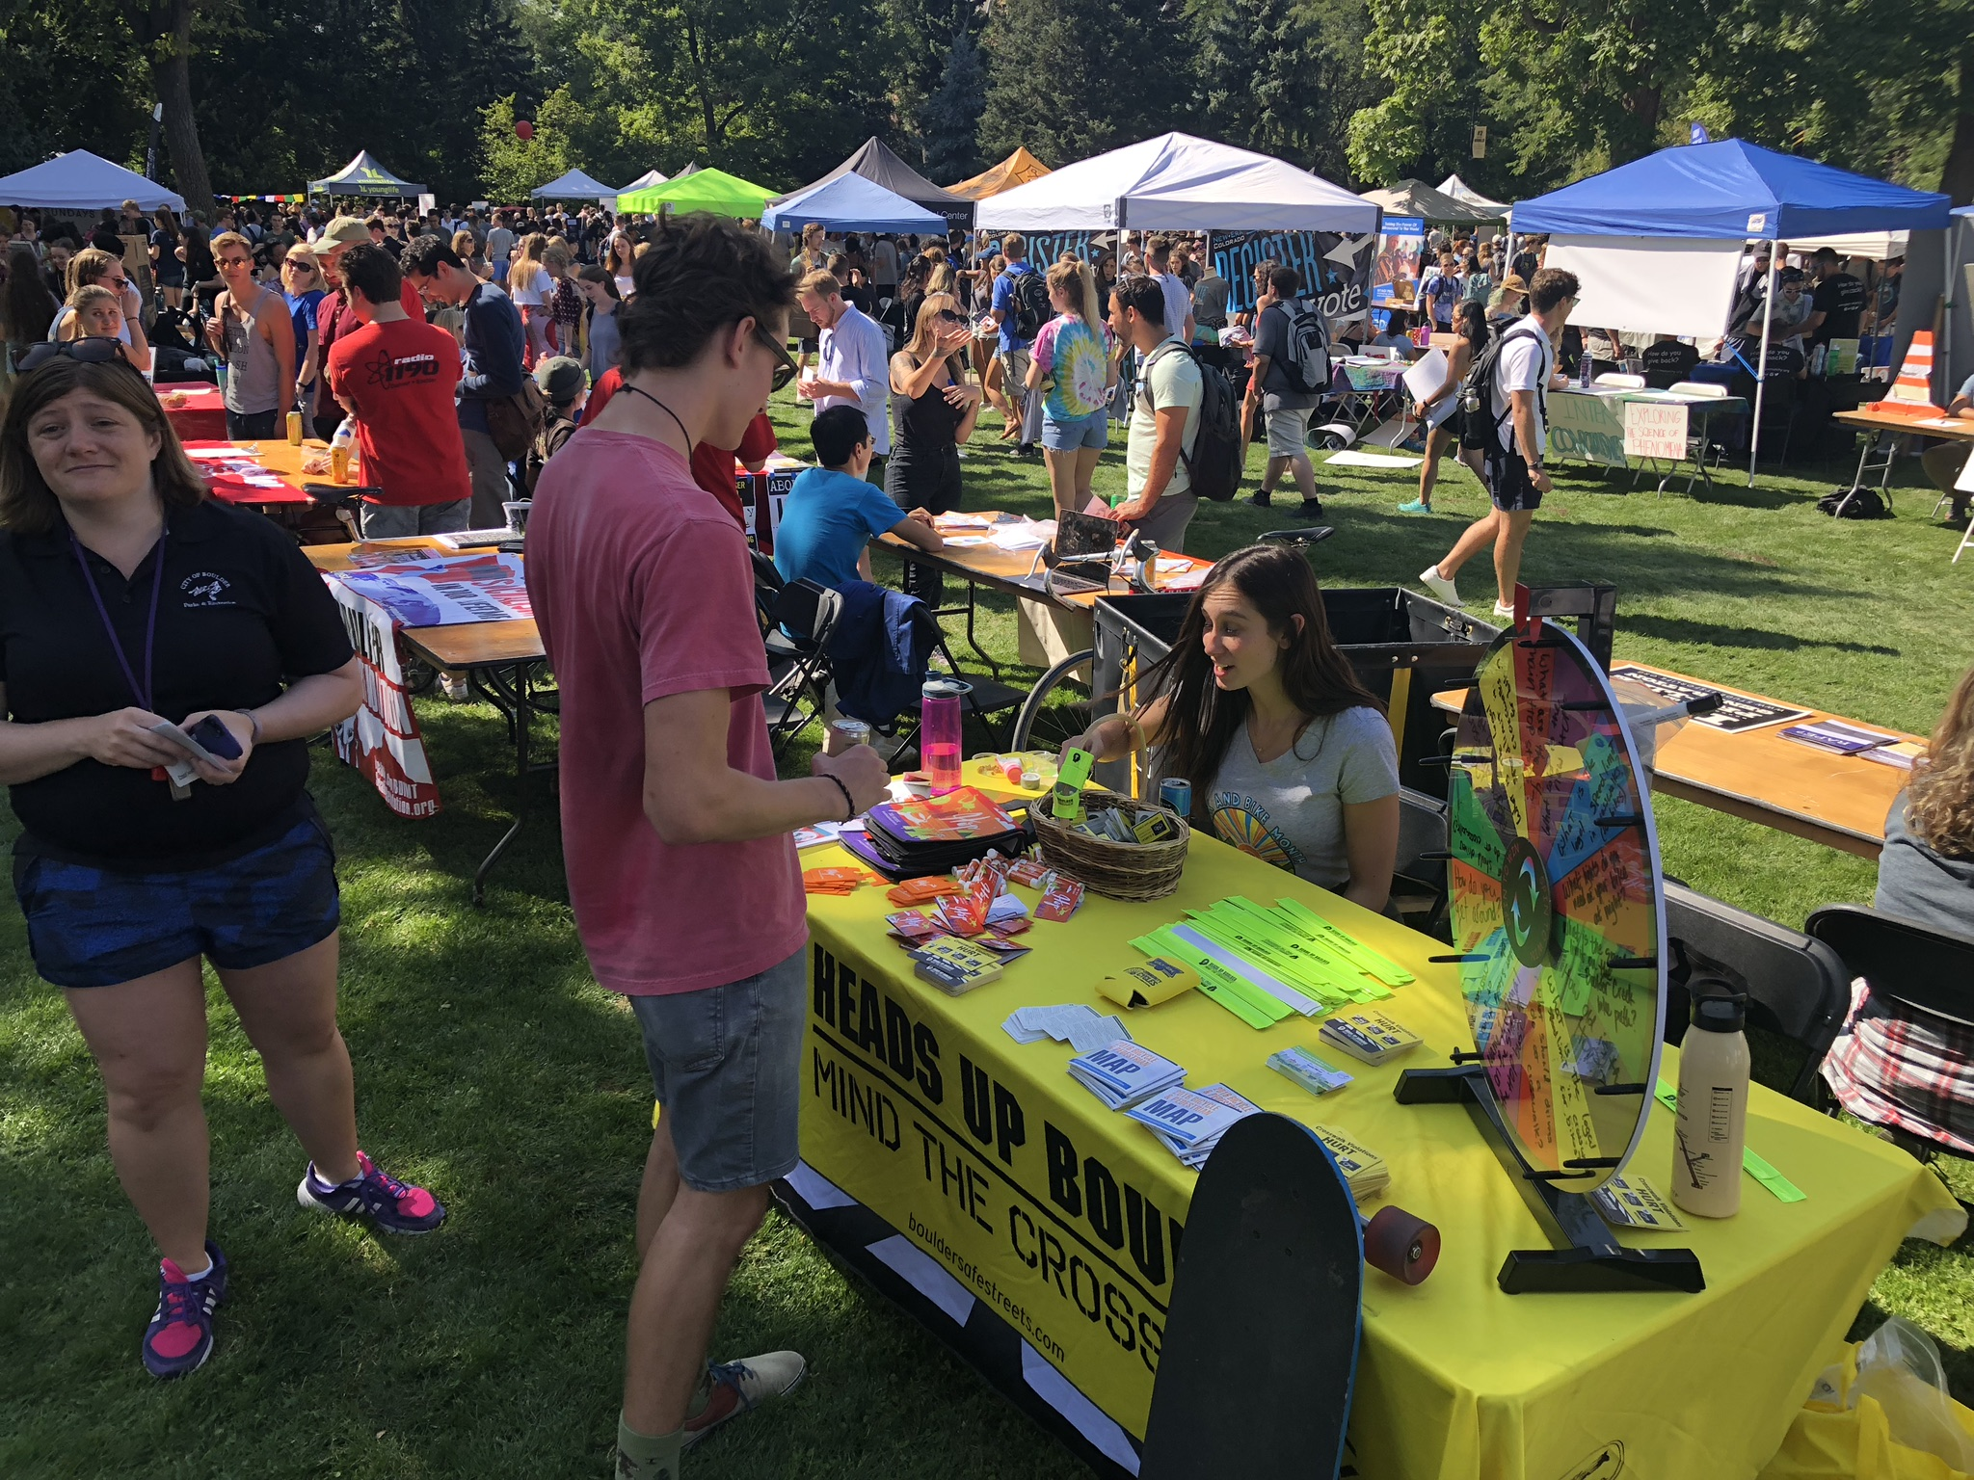
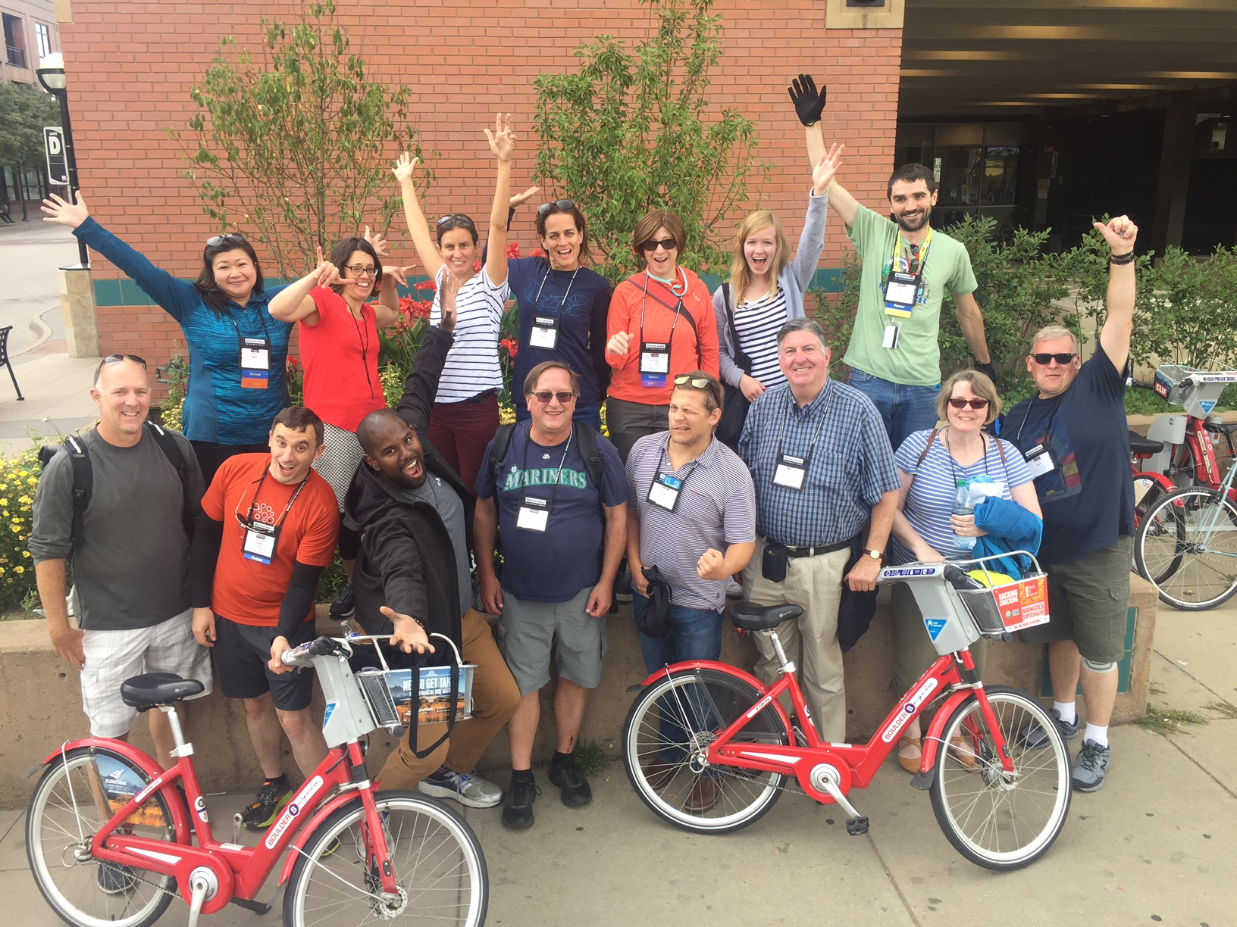
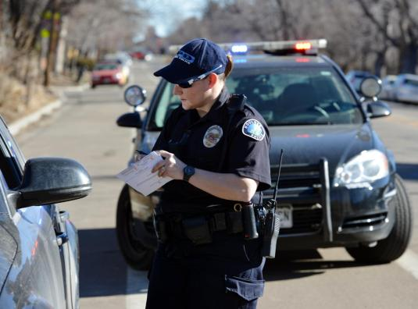
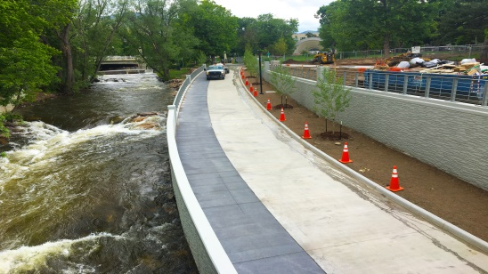
Notes:
Context
4 E’s
Safe Streets = Evaluation

Slide 9
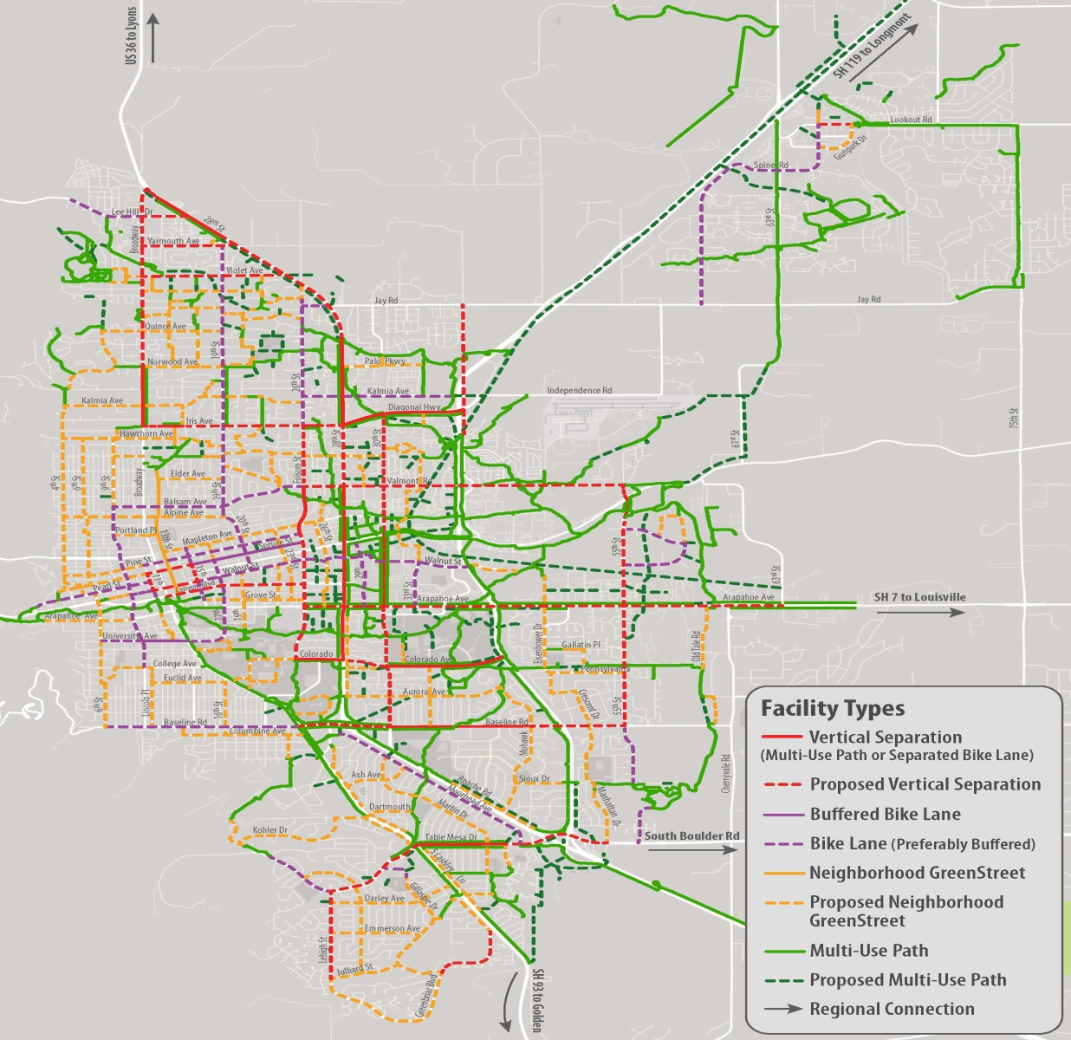

Low Stress Walk & Bike Network
Notes:
Map of Low Stress Bike Network
Citywide network of facilities on which people of all ages and abilities feel comfortable
Different types, vary depending upon the context and available ROW—all connected

Slide 10
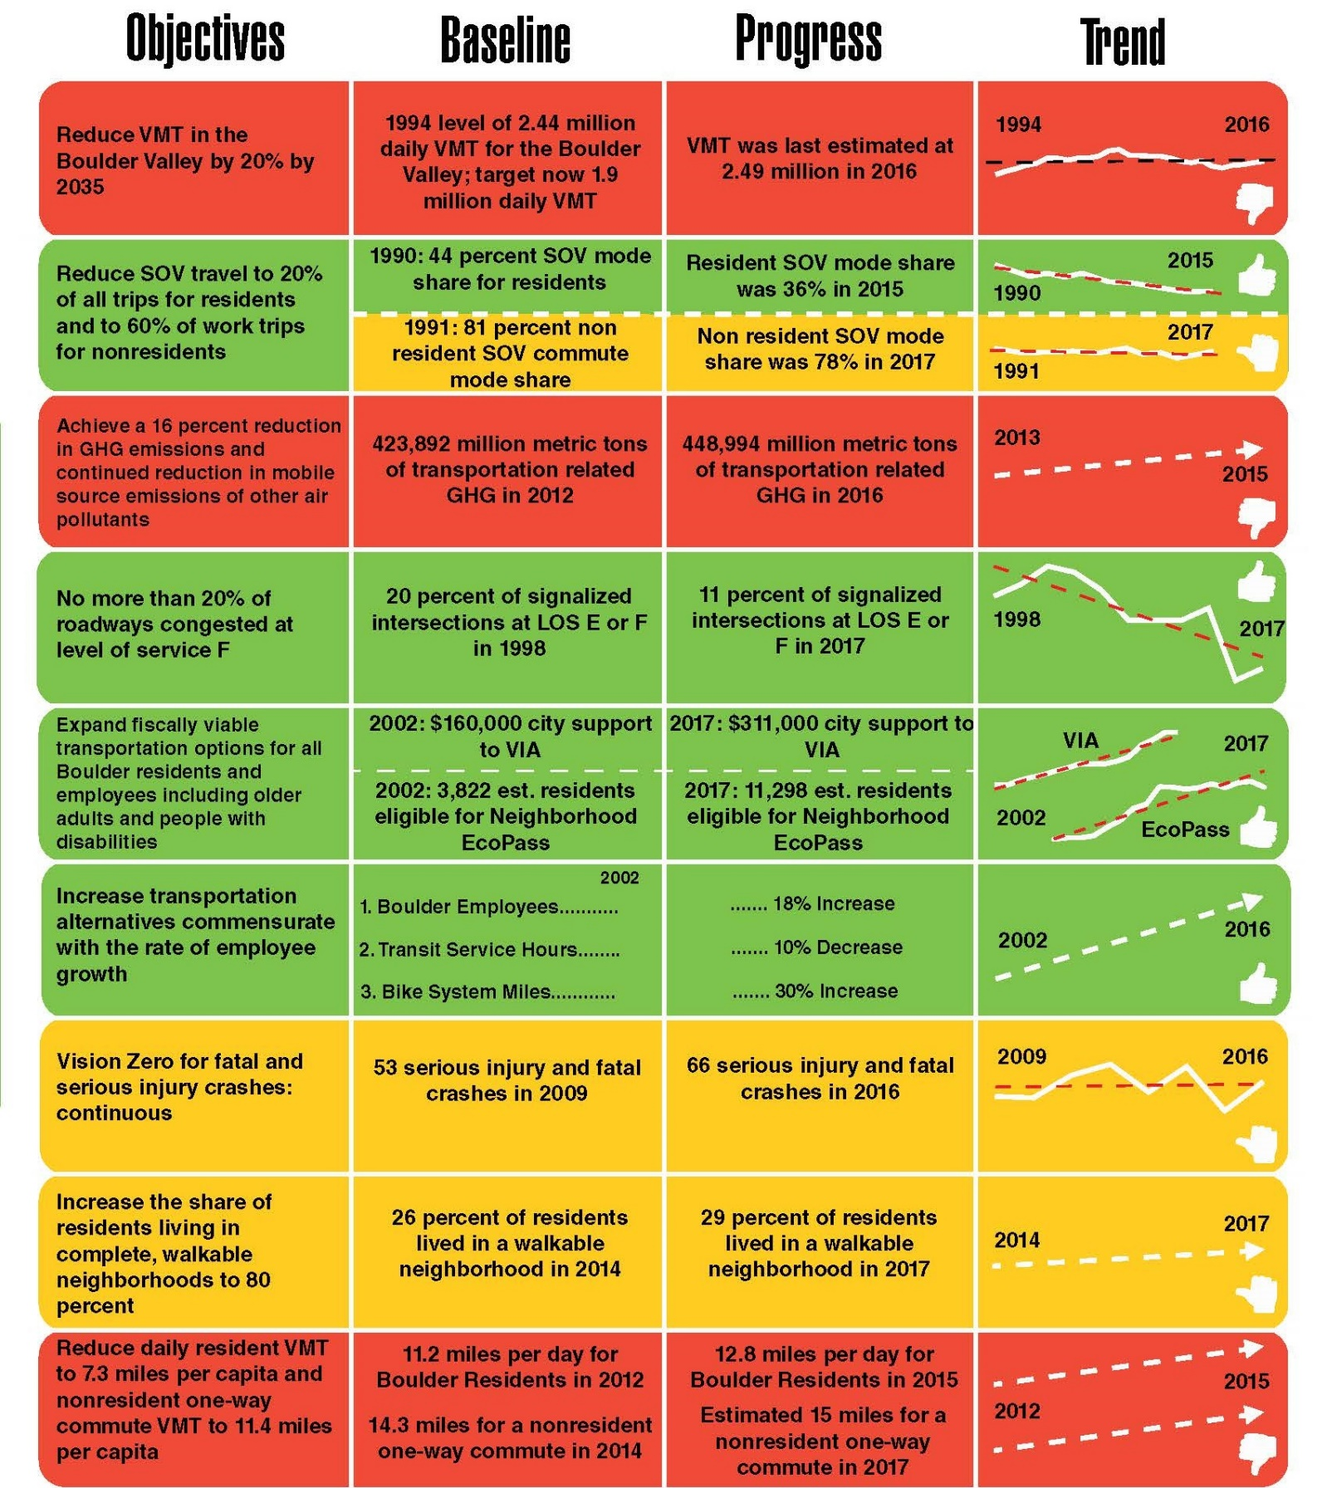
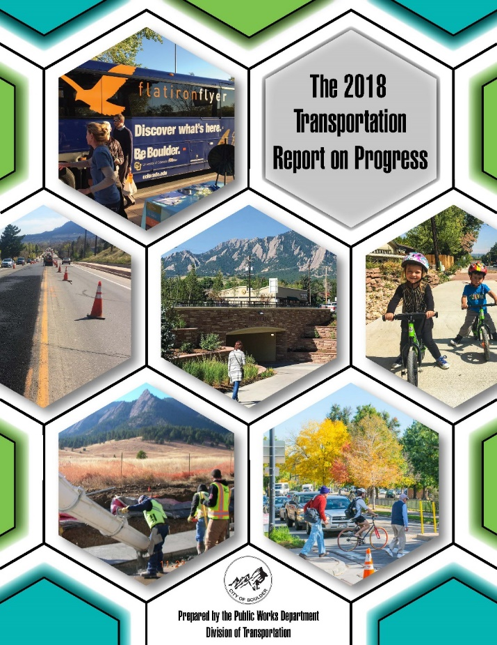
Measuring What Matters
Notes:
We use the nine measurable objectives to track trends over time and focus on areas where continued progress is needed.
Our Report on Progress, which we generally update every two years, evaluates our progress toward the nine measurable objectives. While the report provides much more detail related to each objective, you can see from this summary report card, we report on the status of each objective, with the report also describing those actions anticipated to promote continued progress.

Slide 11
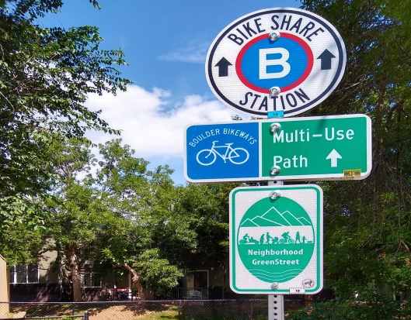


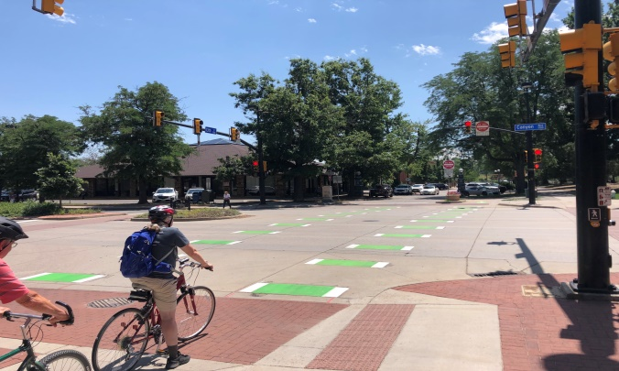
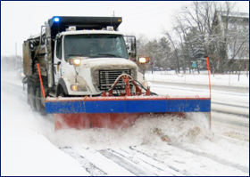
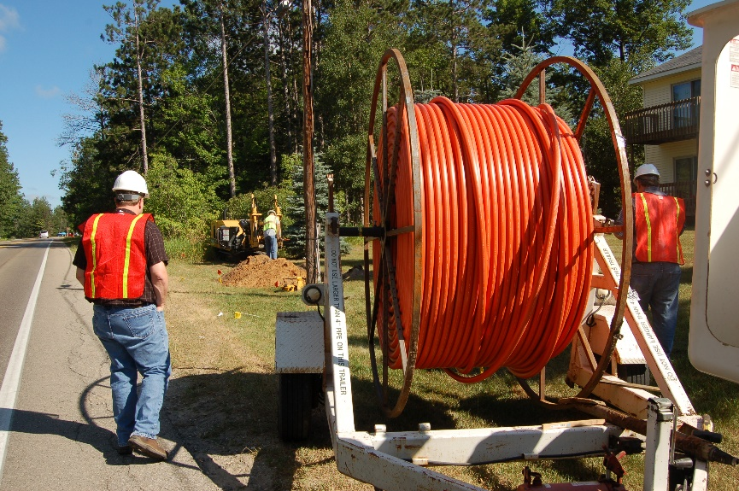

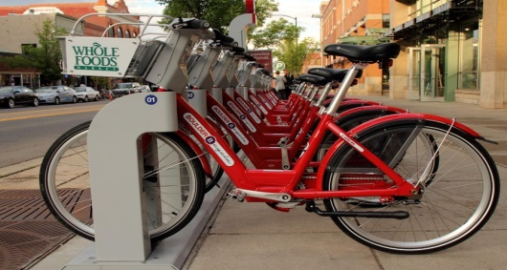
What’s Next?
Notes:
Our key investment themes include safety, mobility, equity, climate, and air quality
These high priority themes are reflected in all the TMP investment program levels from current funding, through strategic, to the ultimate vision program level –but vary depending upon available funds
These investments are also aligned with the Investment Priorities that stated in the TMP.

Slide 12
Thank you - Merci Beaucoup
Mayor Suzanne Jones
  JonesS@bouldercolorado.gov
Kathleen Bracke, GO Boulder Manager & Interim Co-Director of Public Works for Transportation
  BrackeK@bouldercolorado.gov
Boulder Transportation Master Plan:
  https://bouldercolorado.gov/transportation/tmp
Vision Zero:
  https://bouldercolorado.gov/transportation/vision-zero
Climate Mobilization Action Plan:
  https://bouldercolorado.gov/climate/cmap

