Slide 1
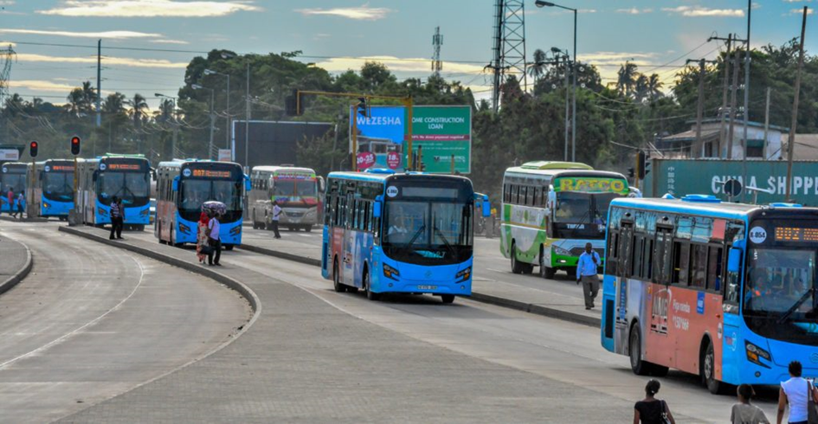
TUMI NETWORK OF HIGH AMBITION LEADERS, TSHWANE NOVEMBER 2018
Bringing Bus Rapid Transit to Tanzania: Steps To Success

Slide 2
Who Is DART
DART is the Government transport Authority which is charged to address the urban transport challenges that has been facing and affecting the mobility of the residents of the city of Dar es Salaam.
The following are the major mandated roles of DART Agency:-
Establish and operate Bus Rapid Transit (BRT) system for Dar es Salaam, branded Dar Rapid Transit (DART),
Ensure orderly floor of traffic on urban streets and roads
Ensure effective Management of the Agency.

Slide 3
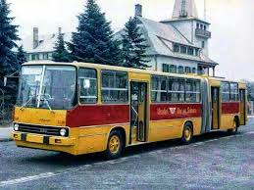
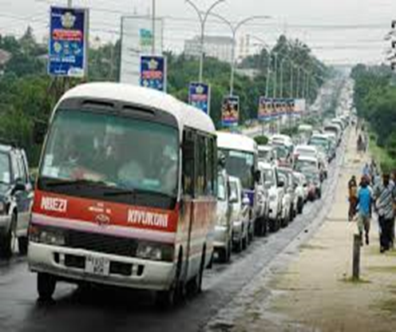
Background: The history of PT in DSM
Public Transport in Dar es Salaam is dated back in 1949
with Dar es Salaam Motor Transport Company (DMT).
DMT nationalized and UDA established in 1967.
Private sector involved from 1983.
Urban PT Challenges:
  Poor roads and Insufficient infrastructure
  Air quality and health issues.
  Low capacity buses and no schedule services
  Congestion

Slide 4
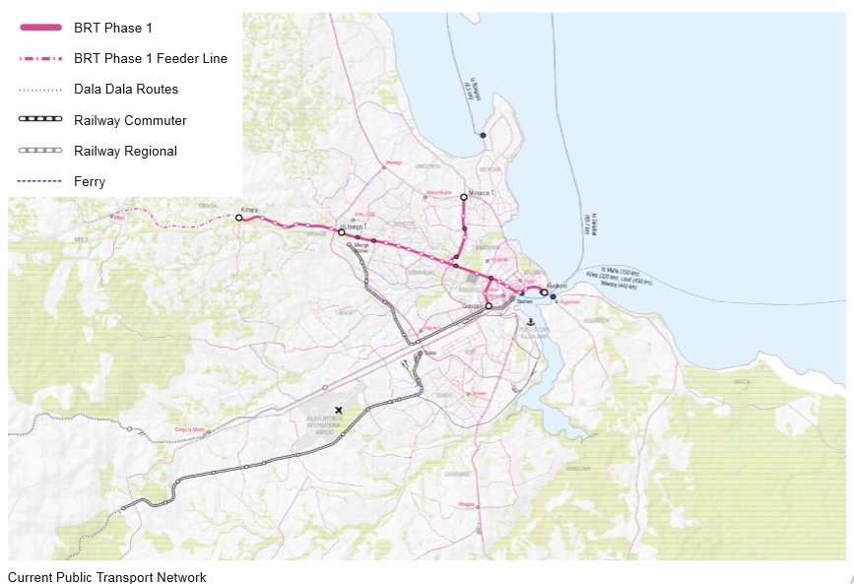
Current PT in DSM

Slide 5
Selection of BRT for DSM
Public Transport System Visualized
Rail based System
  High Cost and Operational Challenges
  Too Big to Fail
Improved Bus System
  Low Cost
  No Operational Risk
  Availability of Affordable Technology AND
  Encourages Participation of Locals

Slide 6
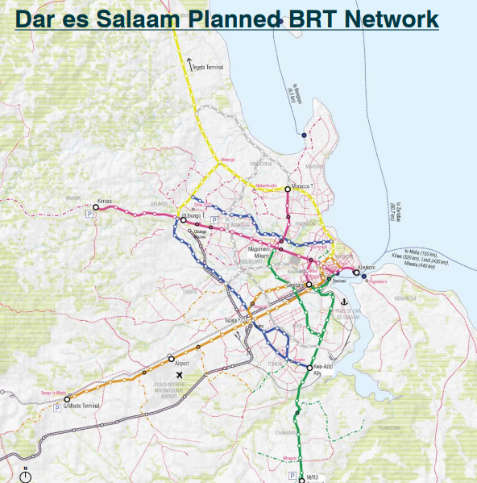
DART System Corridors
Six corridors with a total of
141.1 Km of Trunk lanes

Slide 7
DART System Phase 1 - PPP model Implementation Arrangement

Slide 8
DART System Phase 1 - Operations
With Full Operation Services: - (Gross Cost Model)
305 buses: - 177 Articulated (18M) and 128 Feeder (12M) Buses
Estimated Peak Hour Load 18,000 Passengers
Estimated Daily Ridership 450,000-500,000 per day
Expected Annual Ridership 130 Millions

Slide 9
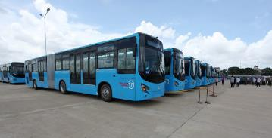
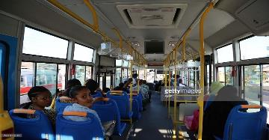
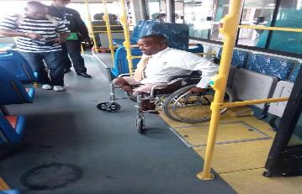
DART Technologies -Buses
1.DART Buses: General Specification – Trunk
(18 m) and Feeder (12m)
Emission Class Euro III technology
Real mountable engine
Propulsion Fuel – diesel
Automatic gearbox-hydraulic retarder
Total pneumatic suspension
Pneumatic brake system
Fuel reserve of 300ltres
Minimum power of 260HP
DART Buses Future Technology
Use of Gas
Euro IV – VI technology

Slide 10
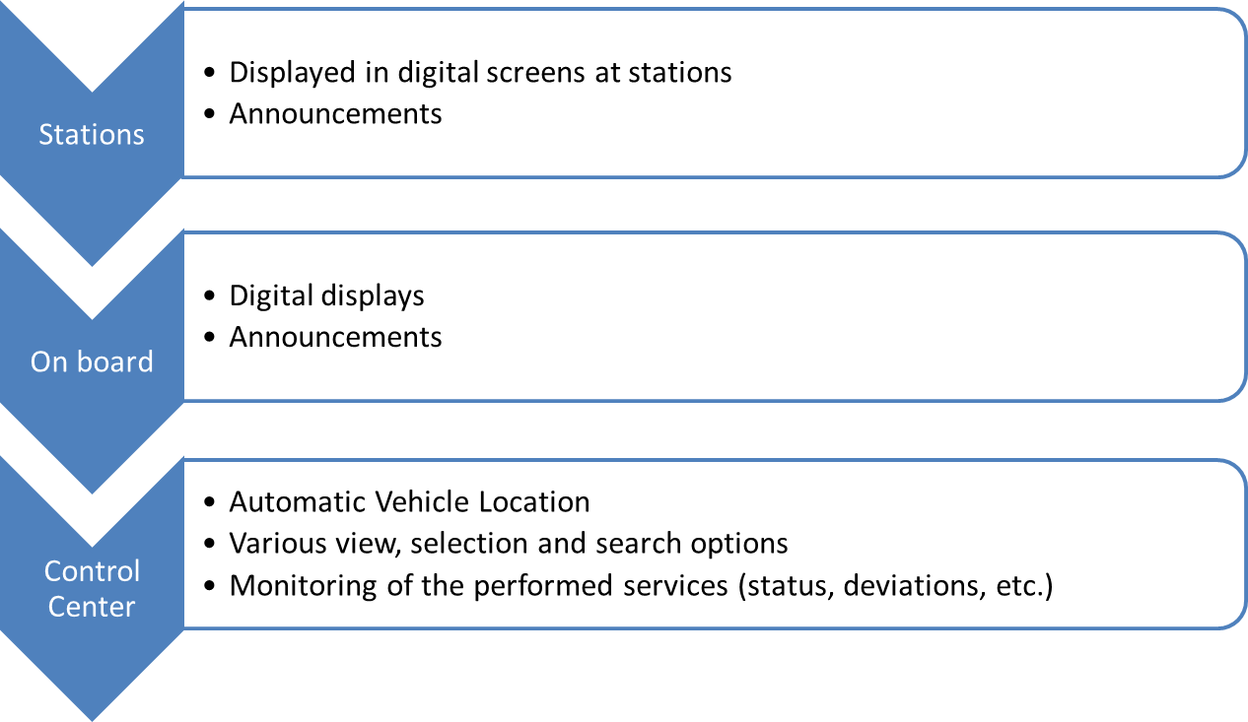
DART Technologies - ITS
One Single Software Platform
ITS -Systems Capability
Real Time Visibility and Tracking of buses
1. automatic vehicle location
2.Various view, selection and search options
3. Monitoring of the performed services (status, deviations, etc.)
Daily Planning
1.Route Planning
2.Bus Scheduling
Operations
Optimization as and when required
RTPI
AFCS
ITS

Slide 11
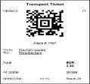
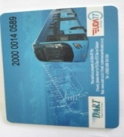
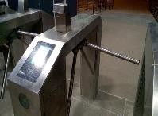
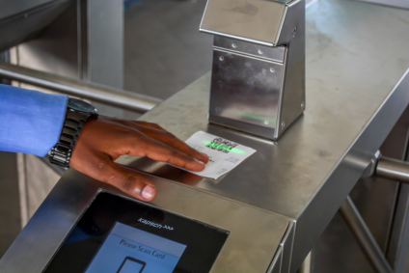
DART System Phase 1- Pre-boarding Tickecting
Ticketing Solution for Buses
Barcode Tickets
Contactless Cards
Automatic Fare collection, clearing and settlement system
Flat Fare
Adult TShs 650
Student TShs 200
Trunk Service
Gerezani
Kivukoni
Kimara
Kimara
Feeder Service
Flat Fare
Adult TShs 400
Student TShs 200
Morocco
Future Products
Intermodal Services i.e Use of one card for BRT and Ferries
Feeder – Trunk – Feeder – TZS 900.00
City Navigator (Mobile App)

Slide 12
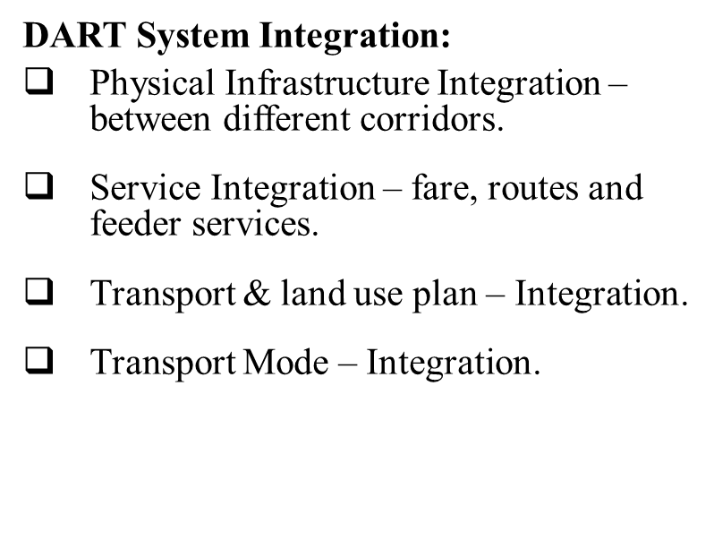

DART System - Integration

Slide 13
Improvement of NMT
Designs of all 6 BRT phases have incorporated the NMT demand
Phase I which has 20.9KM operational has 7km dedicated walkway and cyclist lanes.
A total of 121KM within the city of Dar Es Salaam, has a walkway and cyclist facility,
We have expertise to share, as at different times we had delegation from African countries who came for study visits.

Slide 14
Challenges
We have Several Challenges facing the City of Dar es Salaam which includes:-
Institutionalization challenge ( 6 Local Authorities, SUMATRA, DART, TRL)
A lack of capacity to serve the demands of the growing population;
A lack of traffic control signs, road markings and maintenance;
Congestion in most of the roads e.g Kilwa, Bagamoyo and Morogoro roads etc;
Heavy-goods vehicle traffic on some major wards ;
Low quality, unpaved and poorly maintained streets outside the city centre;
Poor parking Management ;
Little provision for NMT facilities outside the city centre.

Slide 15
DAR CITY NAVIGATOR PROJECT
The Dar City Navigator is a mobile application system envisaged to provide the city of Dar es Salaam with an “Transport and related Information at your fingertips” service.
The tool will functions as an information and multi modal trip planning platform to urban public transport users in the city of Dar es Salaam.
The Dar City Navigator is expected to enhance smart mobility by providing access to a sustainable, inclusive, affordable, safe and urban transport systems and the beta version of App may be attained by May 2019.

Slide 16
Dar City Navigator “Usafiri wa Kiganjani”
Dar City Navigator “Usafiri wa Kiganjani” Project will develop an App that will help commuters to plan their travelling in the city. At minimum the App will save as :-
An Open data portal on public transport (multimodal) that provides real time transportation information and services to commuters and visitors within Dar es Salaam city accessible via different means such as mobile App, social media etc ,
A forum/means for commuters, researchers and stakeholders to send their suggestions and feedback to services providers and regulators for better services improvements and
An interface and integration with other systems like payments systems/gateways including mobile for transportation issues within the App, easy, faster and secured way of transit.

Slide 17
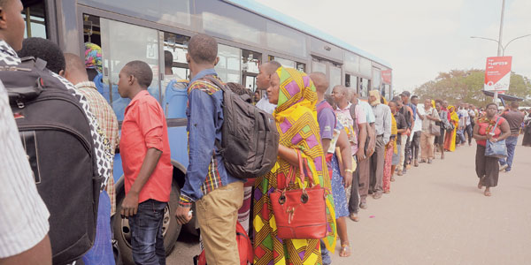
Dar City Navigator “Usafiri wa Kiganjani”
Surely the implementation of Dar City Navigator “Usafiri wa Kiganjani” will resolve scramble in DART System
The use of public transport is currently not “plannable” due to the lack of real-time information.

Slide 18
Our 2 days expectation
learn from others on Ecomobility,
Implement best practice back home,
How to manage suitably Ecomobility,
Share plans, ideas and technology.

Slide 19
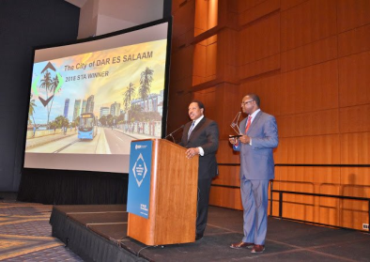
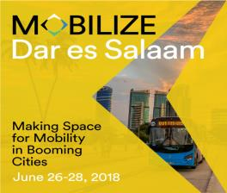
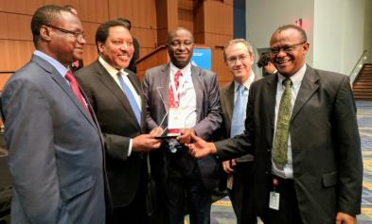
DART system Phase 1 - ACHIEVEMENTS
Dar es Salaam City, Tanzania won 2018 Sustainable Transport Award:
  The transformative nature of the DART system (BRT System), incorporating best practice design as well as world class walking, cycling and access features. these efforts has made Dar es salaam the first African city to win the Sustainable Transport Award in its 13-years history.
  Some of the criteria for winning: Bus operations, appropriate infrastructure, provision for Non-Motorized Transport – cyclists, pedestrians, provision for disadvantaged.
  The 2018 STA was officially presented in January 9, 2018, during the Transportation Research Board Conference which was held January 7 - 11,2018 in Washington DC, USA.
  As the winner of 2018 STA, Dar es Salaam hosted the international sustainable transport summit, MOBILIZE , 26 – 28 June 2018.

Slide 20
THANKS

