Slide 1
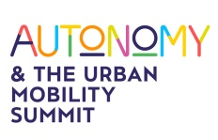

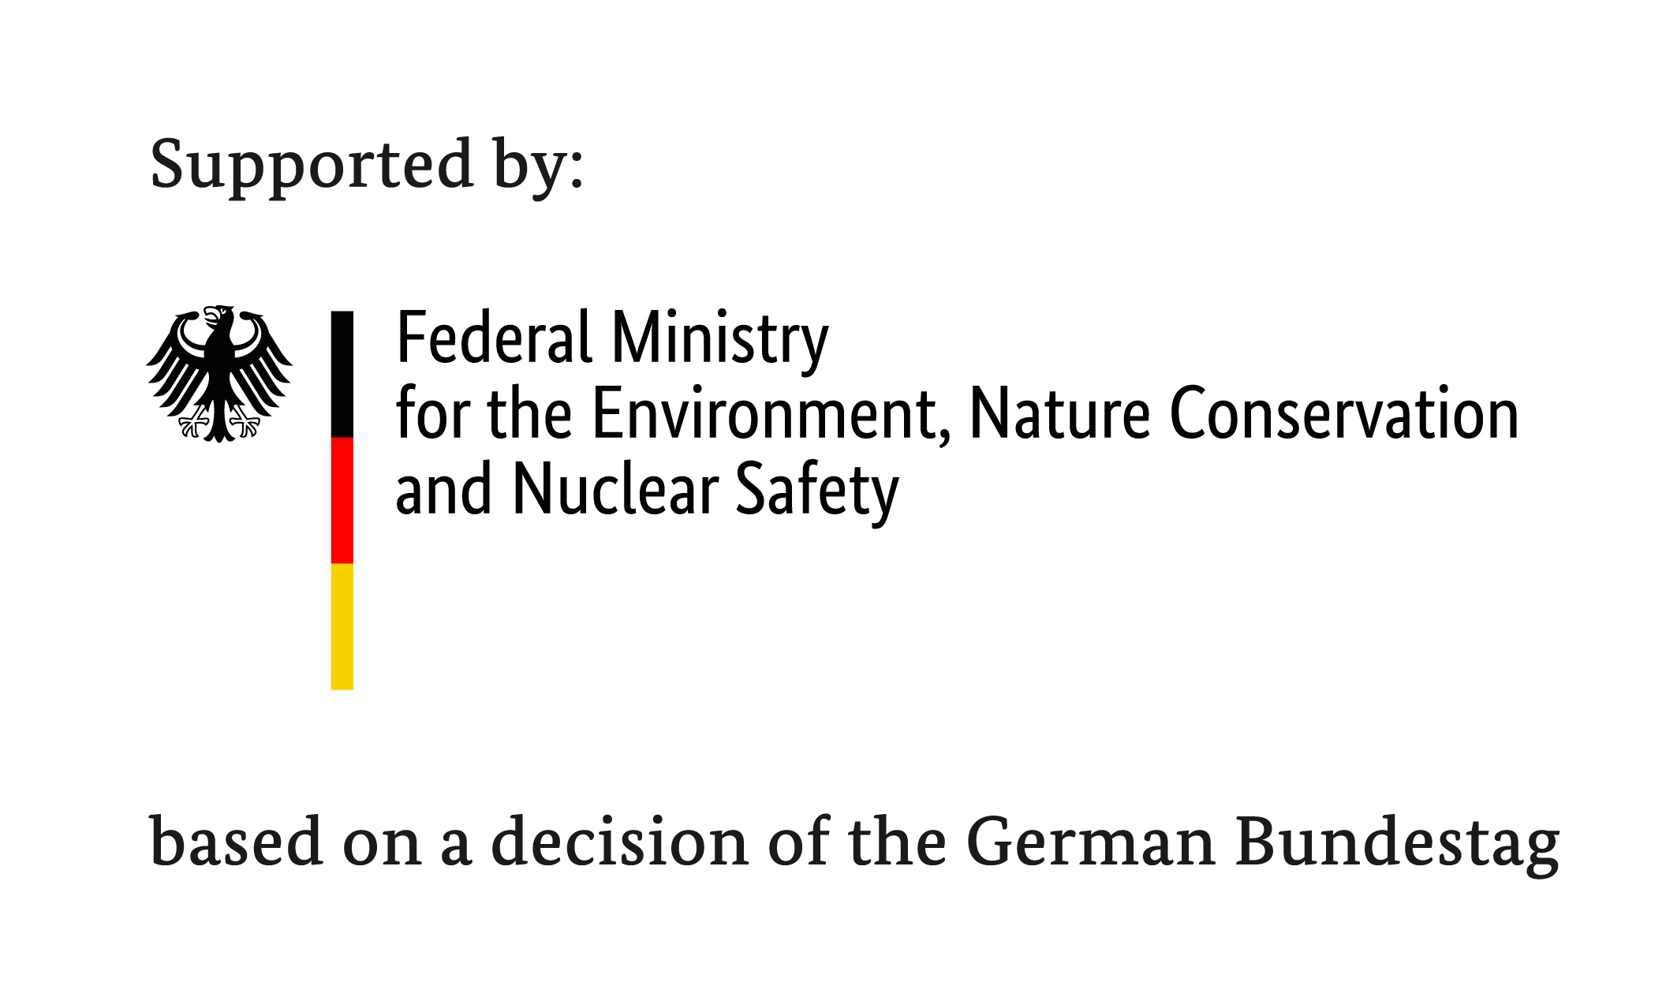






EcoLogistics
Low carbon freight for sustainable cities
16 Oct, 2019, EcoMobility Days at AUTONOMY, Paris

Slide 2
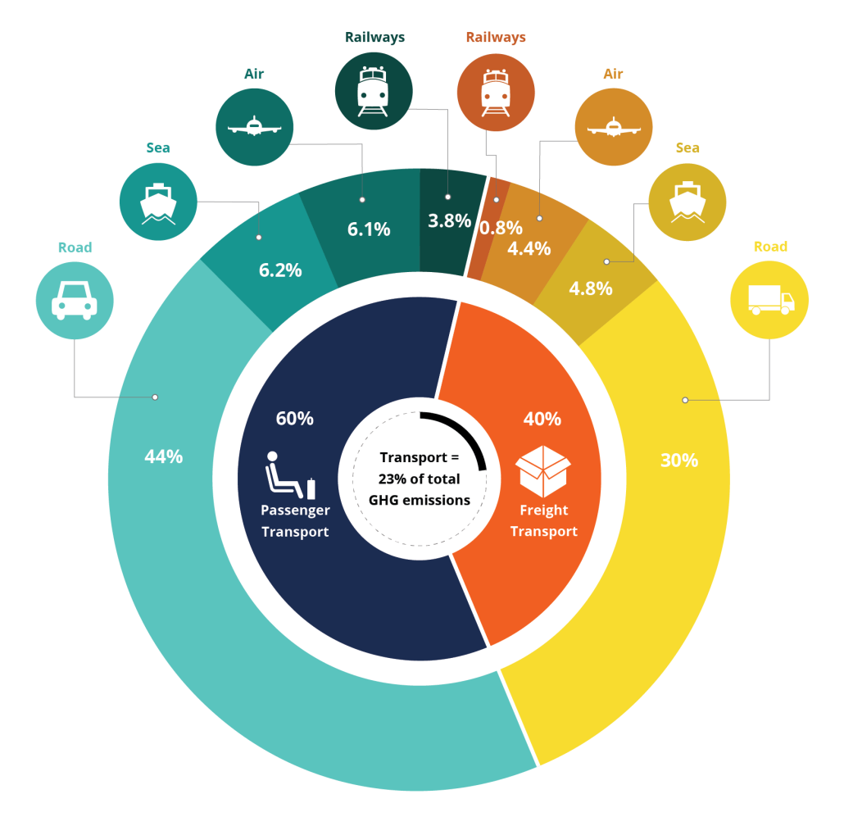


urban freight in a nutshell
Movement of goods made by light or heavy vehicles, as well as non-motorized transportation modes
55% of population living in urban areas (68% in 2050)
Freight transport volume: projected to increase by 230% by 2050
If unchecked, transport CO₂ emissions could increase by 60% by 2050
Worldwide, urban freight represents up to:
Transport =
14% of total
GHG emissions
40%
of occupied
road space
25%
of kilometers travelled by
vehicles
40%
of urban transport related CO₂ emissions
Source: ICLEI EcoMobility, (adapted from Kodjak D, 2015, Policies To Reduce Fuel Consumption, Air Pollution, and Carbon Emissions from vehicles in G20 Nations, May 2015, The International Council for Clean Transportation (ICCT), ITF 2017, Accenture research)
2
Notes:
- Urban freight includes: Includes retail, waste, construction and road services, the hotel, restaurant and catering industry, as well as express courier and post
- 55% of population live in urban areas today (68% expected in 2050 - 90% increase in Asia and Africa only)

Slide 3

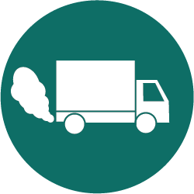
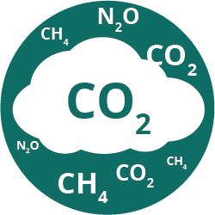






The impacts of urban freight
Outdoor air pollution:
  4.2 million premature deaths in 2016 (91% in low/middle-income countries)
  Affects particularly children, elderly and other vulnerable populations
Noise and vibration of delivery trucks at night: perturb sleep
Road maintenance: damage road surfaces
Road safety: heavy goods vehicles = 5% of traffic but involved in 18% of cyclists’ road deaths each year
Congestion: 50% increase in urban traffic between 1998-2008 due to heavy goods vehicles
Emissions: heavy goods vehicles responsible for 21% of CO₂ emissions from road transport
Air pollution
GHG emissions
Noise pollution
Traffic safety
Congestion
Waste production
Land degradation
Urban quality of life
3

Slide 4
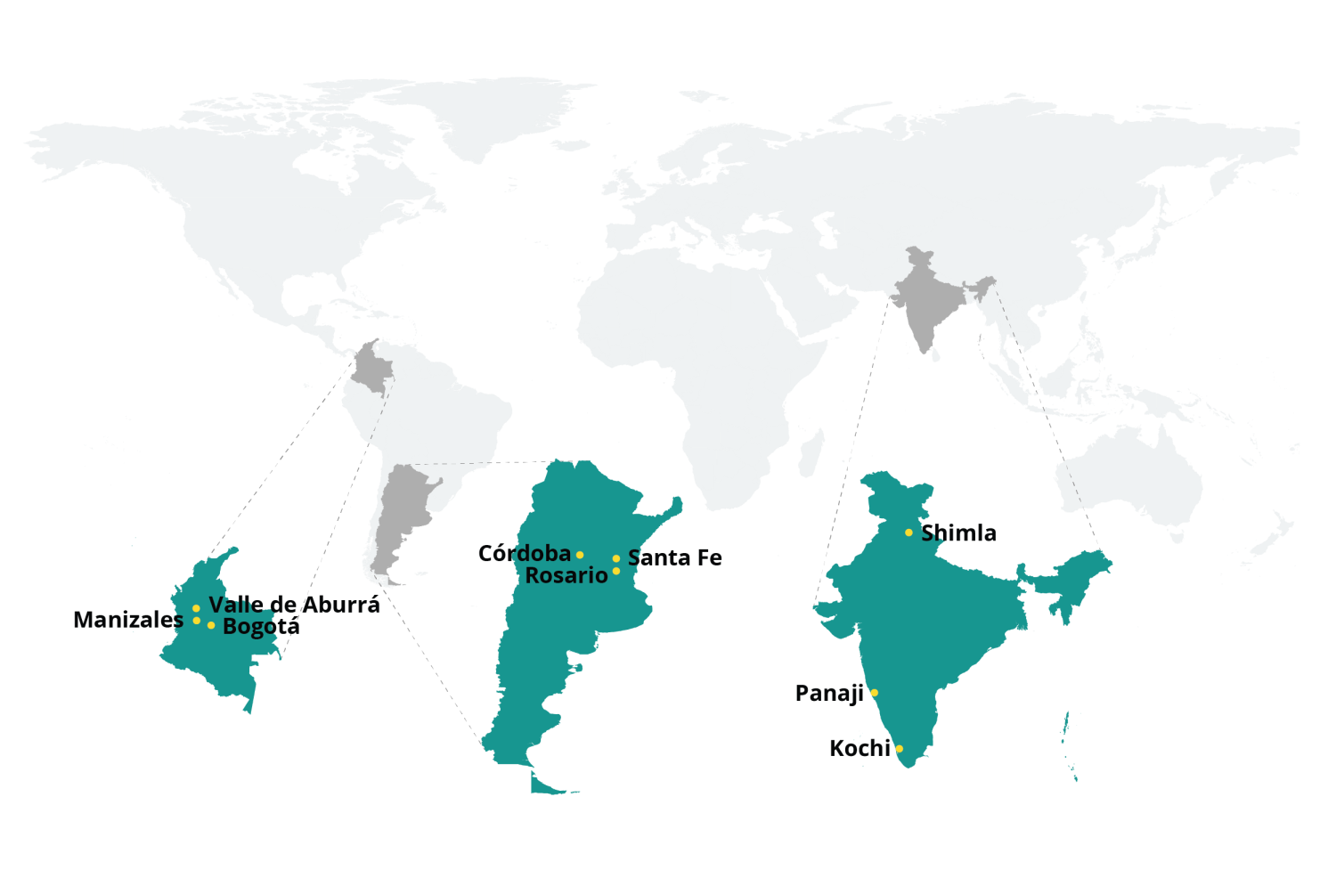
ICLEI’s EcoLogistics project
“EcoLogistics” promotes transportation of goods by giving priority to health, safety, people-centered urban development and low emissions, while also encouraging circular and regional economies to limit the growth of freight transport.
ICLEI’s “EcoLogistics” project (2017-2021) will capacitate governmental and non-governmental actors to build strategies and policies to promote low carbon and more sustainable urban freight through local actions and national support in nine project cities in Argentina, Colombia and India.
Argentina
India
Colombia
4
Notes:
It minimizes impacts on air quality, noise, health, fatalities and injuries, traffic congestion, while also reducing GHG emissions, improving livability and contributing to climate change mitigation.

Slide 5








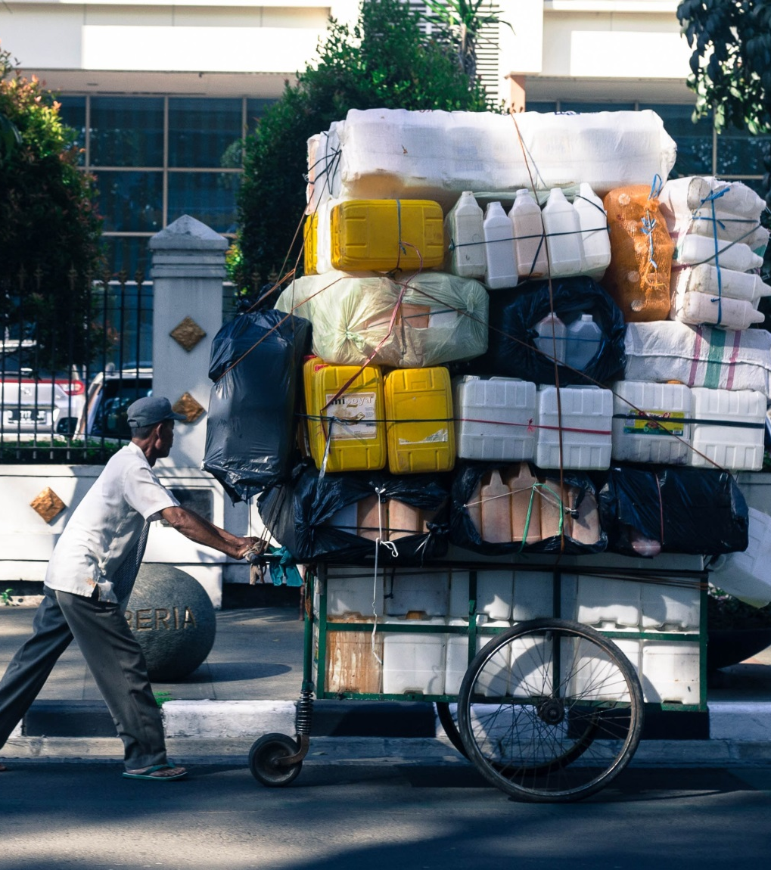
Project outputs
Main objectives
Establish multi-stakeholder working groups with key actors from the freight sector
Develop a self-monitoring tool to measure the impacts of urban freight in terms of CO₂ emissions in each city
Collect data on urban freight for each city, create city freight profile and have them accessible online
Create Low Carbon Action Plans for Urban Freight to reduce GHG emissions
Create demonstration projects in each country
Propose National EcoLogistics Policy Recommendations for each country
Disseminate knowledge on urban freight and the project’s results, challenges and lessons learned through the creation of a handbook, webinars and conferences
5

Slide 6
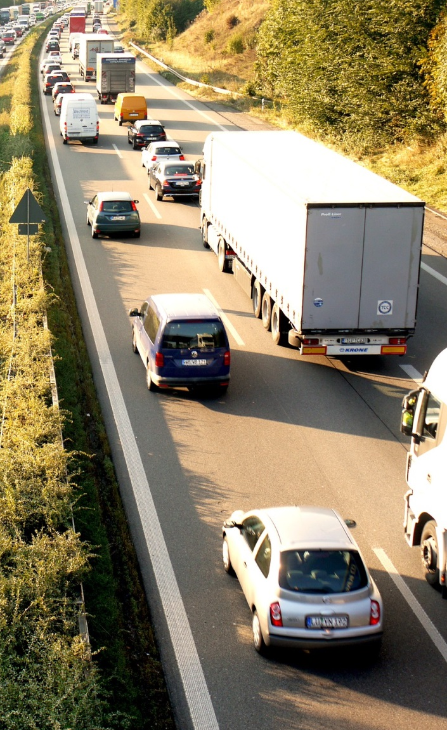
Many challenges to overcome
Lack of discussion and data on (urban) freight transport
Fragmentation, lack of alignment/consensus and different priorities between stakeholders
Important fragmentation and deregulation of transportation markets
Lack of compliance amongst transportation operators
E-commerce and new technologies influence parcel delivery services and traffic
Large shopping malls in city outskirts or suburbs increase traffic
Constant changes within industrial production = changes in already-complex supply chains
Developing countries:
High population density and growth
Slow development of infrastructure
Omnipresence of the informal sector
Diversity of urban fleet
6
Notes:
Lack of discussion on (urban) freight transport (not “sexy”)
Fragmentation, lack of alignment/consensus and differeent priorities between stakeholders (shippers, receivers, transport operators)
New technologies increase expectation in terms of delivery performance

Slide 7
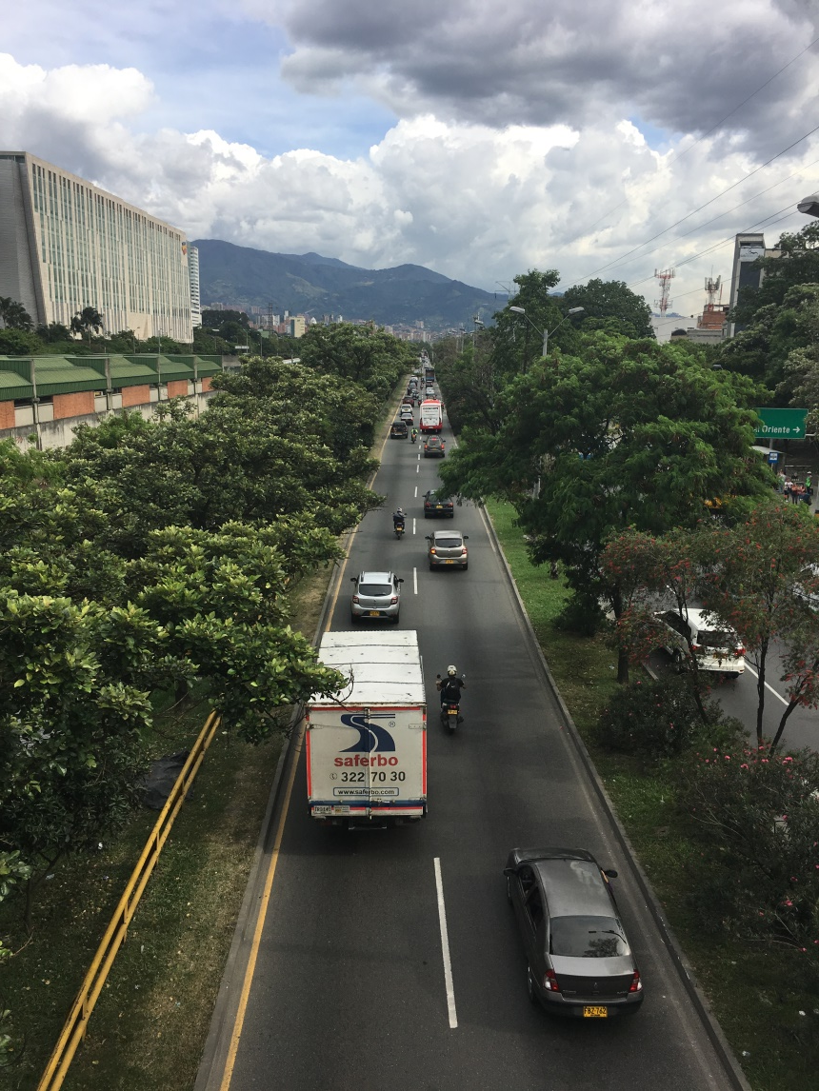

EcoLogistics approach
Baseline setting
  Who are active in urban freight? – Multi-stakeholder working group
  Data collection on urban freight (surveys, interviews)
  How to measure it? – Self-monitoring tool
Real change
  Capacity building workshop for all stakeholders
  Alignment from national to regional to city level stakeholders
  Pilot project concepts
  Implementation of Demonstration projects
For a more sustainable future
  Providing project scenarios in urban freight
  Low-Carbon Action Plan for Urban Freight
  National EcoLogistics Policy Recommendations
Global outreach
  Reporting on best practices
  Experience sharing at international events
7

Slide 8
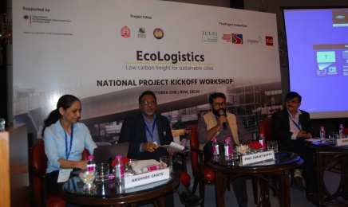
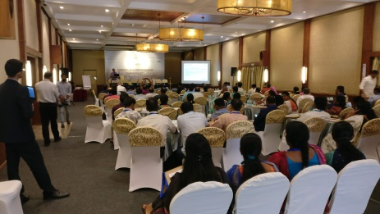
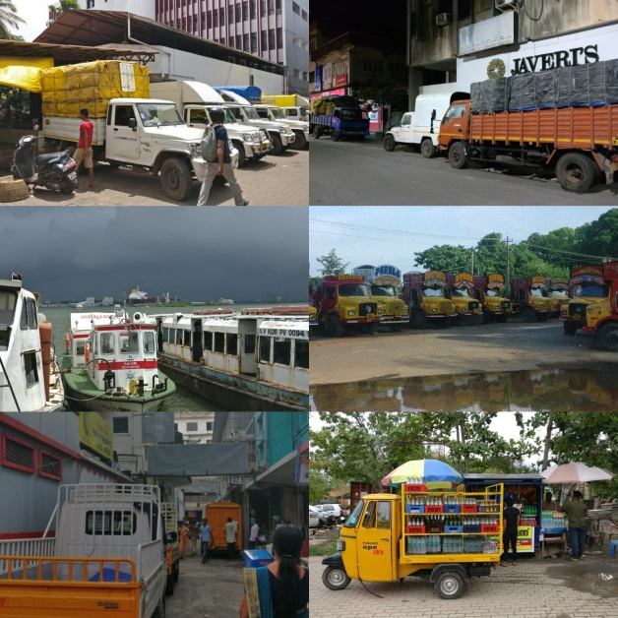
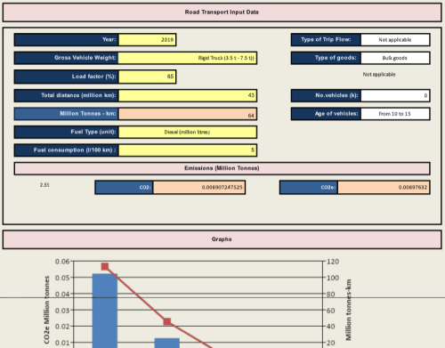
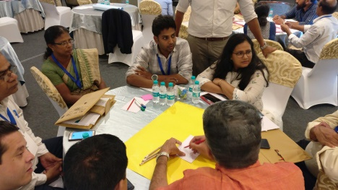
How it actually works (1/3)
Stakeholder engagement
Self-monitoring tool
Project brainstorming
Pilot project site visits
8

Slide 9
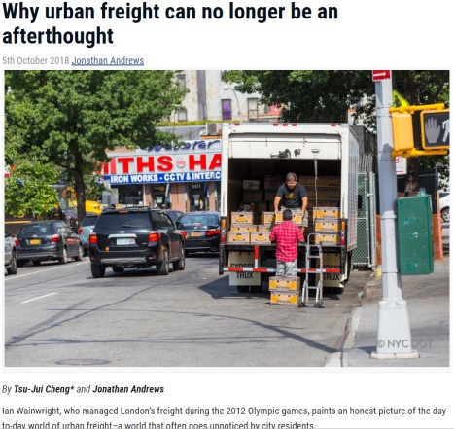
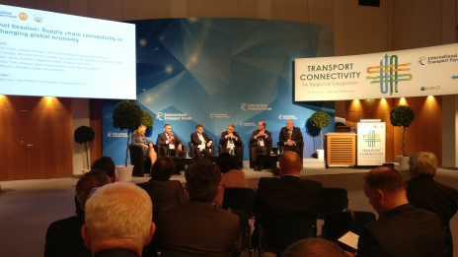
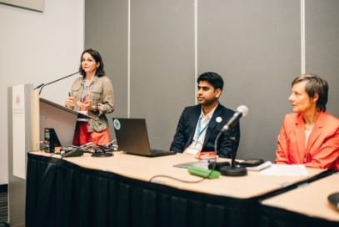
How it actually works (2/3)
Media exposure
Why urban freight can no longer be an afterthought. CitiesToday. 5th October 2018 https://bit.ly/2ywAg5z
Urban freight and supply chain connectivity in a changing global economy. CityTalk. 3rd June 2019 https://bit.ly/2Y4BK2M
Mayor calls for relocation of godowns to suburbs. The Hindu. 8th June 2019 https://bit.ly/2WOQgyZ
Expert: UMTA must regulate freight movement to decongest city roads. The Hindu. 8th June 2019 https://bit.ly/31EvIYR
Training for commercial vehicle drivers. The Hindu. 9th June 2019 https://bit.ly/2Iq6Qfw
Global outreach
ICLEI World Congress. “EcoLogistics: the next level for sustainable urban mobility?” Montreal, Canada. 19-22 June 2018 https://bit.ly/2ITNLBy
International Transport Forum. “Supply chain connectivity in a changing local economy” Leipzig, Germany. 22-24 May 2019. https://bit.ly/2E7qBGt
Autonomy & Urban Mobility Summit. Corporate Mobility” Paris, France. 16-17 2019. (tbc)
9

Slide 10
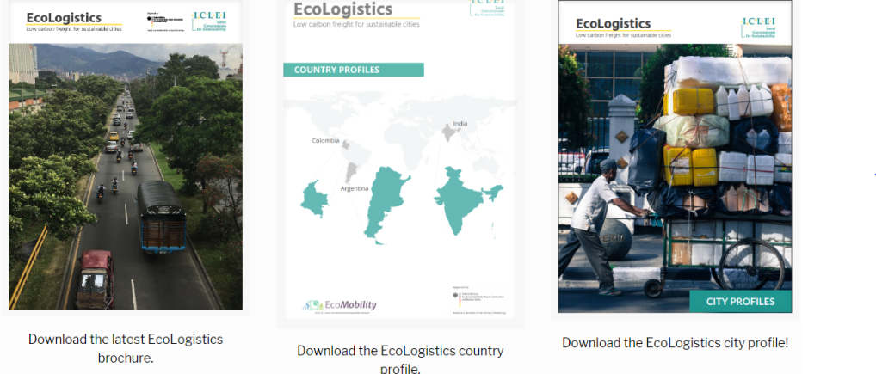
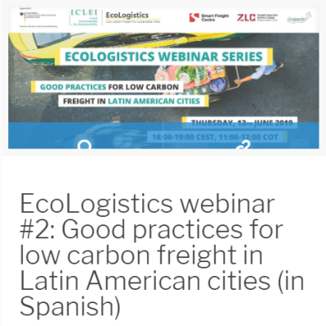
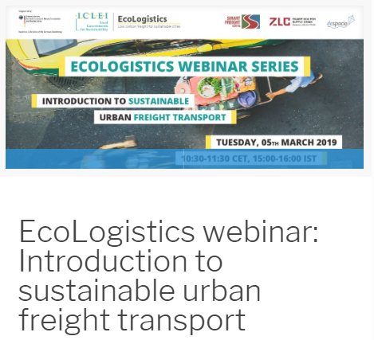
How it actually works (3/3)
Knowledge products
Peer-to-peer learning and exchange
10

Slide 11
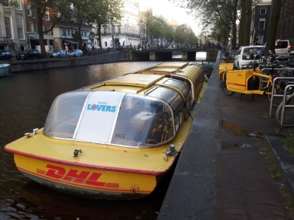
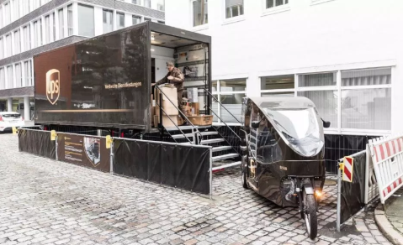
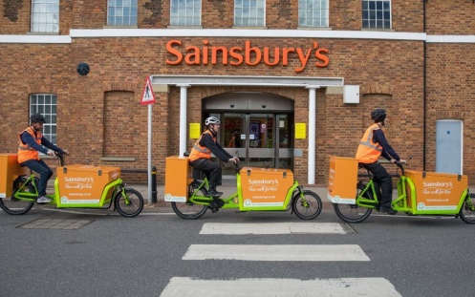
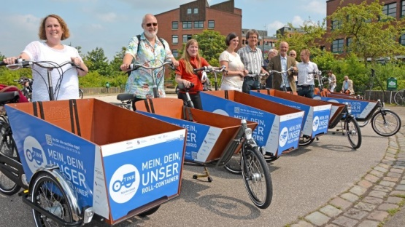
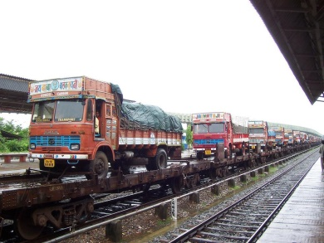
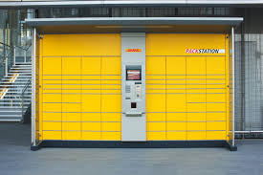
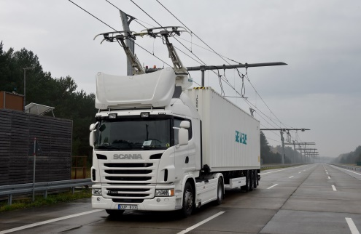
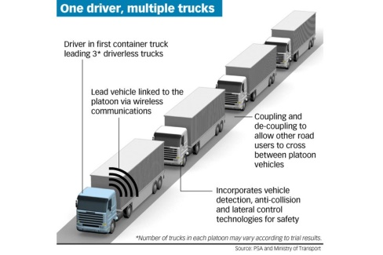
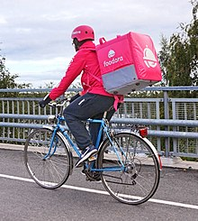
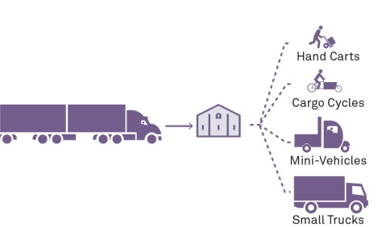

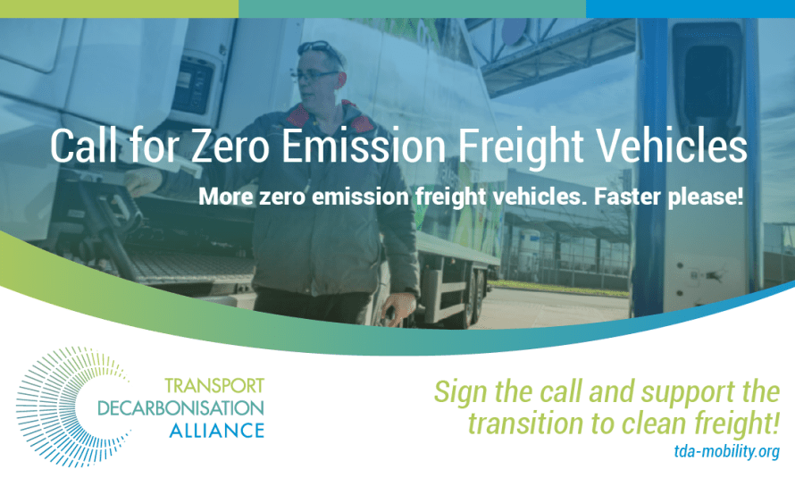

Solutions are available
11
Notes:
Lack of discussion on (urban) freight transport (not “sexy”)
Fragmentation, lack of alignment/consensus and differeent priorities between stakeholders (shippers, receivers, transport operators)
New technologies increase expectation in terms of delivery performance

