Slide 1
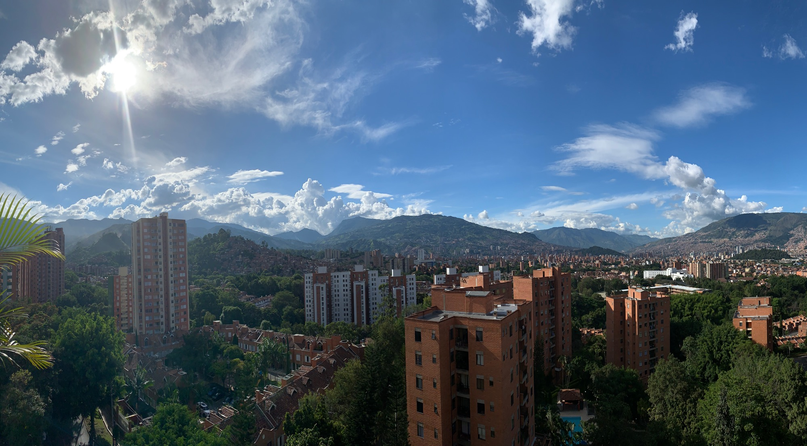
Regional Logistics Plan
Metropolitan Area of the Aburrá Valley Colombia
October 2019

Slide 2
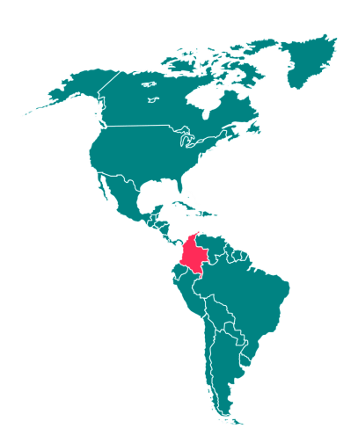
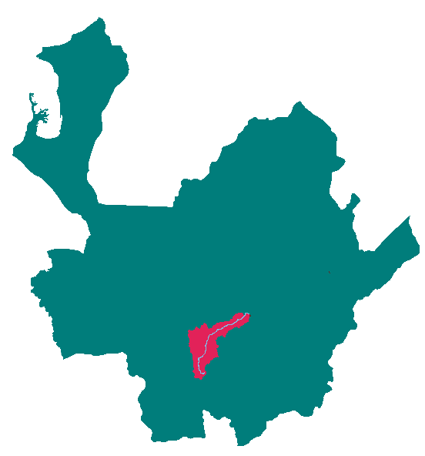
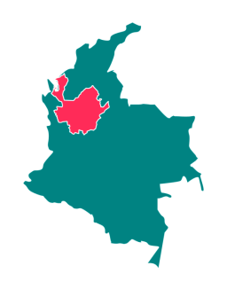
Vehicle Renewal Project for the Aburrá Valley
Context
TERRITORY
Worldwide
National
Departmental
Colombia | In America
49’757.609 inhabitants
Antioquia | In Colombia
6’691.030 inhabitants
Aburrá Valley | In Antioquia
3’909.729 inhabitants

Slide 3
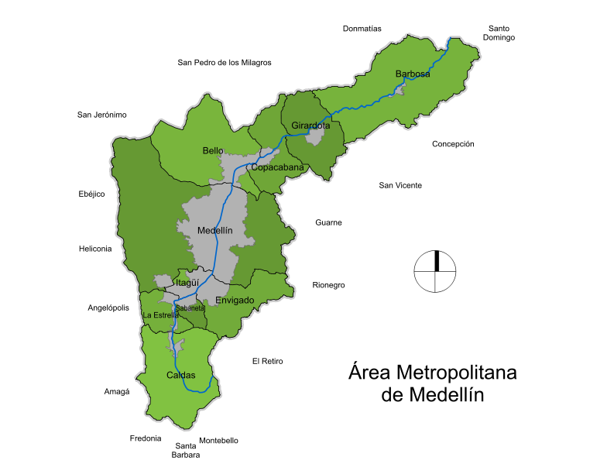
Vehicle Renewal Project for the Aburrá Valley
Context
TERRITORY
Metropolitan
Antioquia
Municipalities of the Aburrá Valley and the Metropolitan Area
Barbosa
Girardota
Copacabana
Bello
Medellín
Itagüí
Envigado
La Estrella
Sabaneta
Caldas

Slide 4
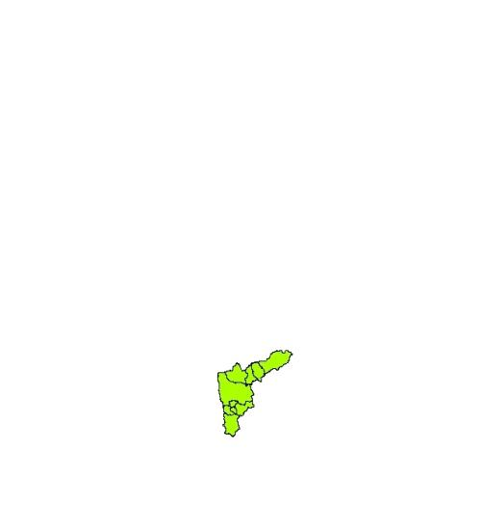
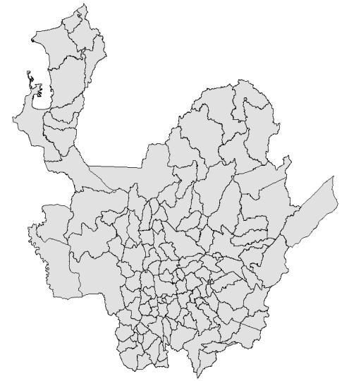
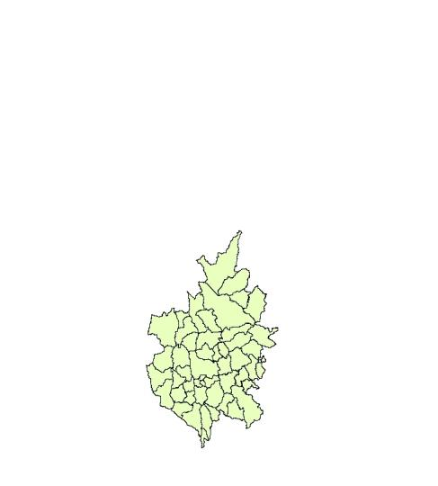
Vehicle Renewal Project for the Aburrá Valley
Context
DEPARTMENTAL CONTEXT
POPULATION CONCENTRATION WITHIN THE ABURRA VALLEY
Inhabitants (2016 DANE´s projection)
Sk2 Area
Escarpe
Escarpe
Depósitos
de Vertiente
ANTIOQUIA
125 municipalities
Planicie aluvial
Planicie aluvial
6’691.030
63,612 Sk2
ABURRA VALLEY
10 municipalities
3’909.729
1,152 Sk2
Urban ground 29,5%
340 Sk2
Rural ground 70,5%
812 Sk2
58,5%
Is located in
Of Antioquia´s population
1,8%
Of the Department´s area
Population located in the urban soil of the 10 municipalities
95%

Slide 5
Vehicle Renewal Project for the Aburrá Valley
Context
GENERAL CONTEXT OF THE ABURRÁ VALLEY CONURBATION
1915 - 1918
1948 - 1970
1970 - 1985
1985 - 1996
1996 - 2015
A growing population requires more and more...
+ Housing
+ Equipment
+ Means of transportation

Slide 6
Vehicle Renewal Project for the Aburrá Valley
Context
GENERAL CONTEXT OF THE ABURRA VALLEY TOPOGRAPHY
7 Km
Scarp
1 Km
Scarp
Slope deposits
Slope deposits
Alluvial plain
Alluvial plain
Taken from: POMCA Digital Elevation Model
The Aburrá Valley:
An elongated topographical depression that can be divided into two sections
Narrow valley, which expands into the municipality of Medellín reaching about seven kilometers in width. It closes in the ancones, to the south in La Estrella and to the north in Copacabana.
The Aburrá Valley is a 1,000 depression meters deep, located towards the center of the northern part of the Cordillera Central, which is limited by high plateaus.
Serranía de las Baldías 3120 m.a.s.l.
Aburrá River in Barbosa 1130 m.a.s.l.

Slide 7
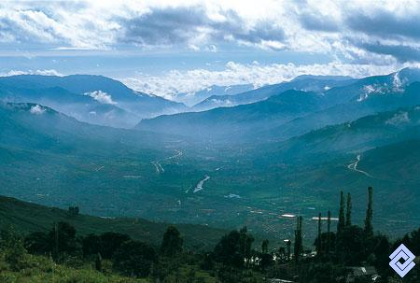
Aburrá Valley a narrow canyon
Vehicle Renewal Project for the Aburrá Valley
Context

Slide 8
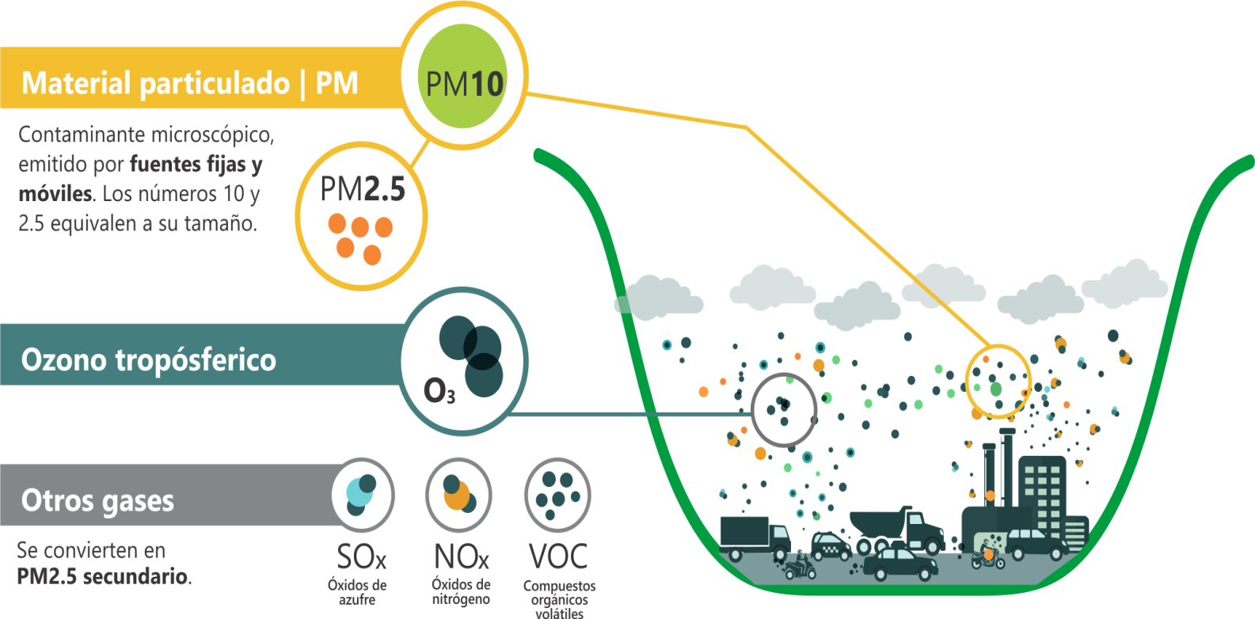
Vehicle Renewal Project for the Aburrá Valley
Difficulties
CONTAMINANTS

Slide 9
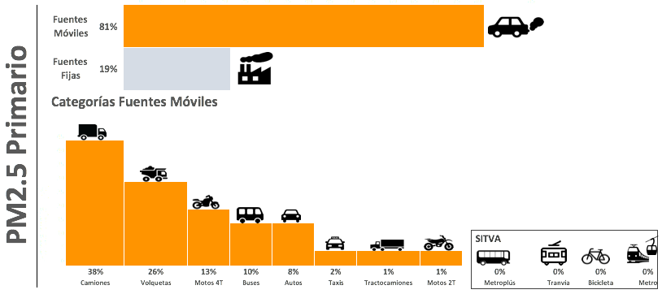
Vehicle Renewal Project for the Aburrá Valley
Difficulties: SOURCES
64%
Emissions inventory for base year 2015

Slide 10
Vehicle Renewal Project for the Aburrá Valley
Difficulties: AGE OF VEHICLE FLEET
DISTRIBUTING CARGO IN URBAN AREAS
50% MORE THAN 15 YEARS OLD
Poor governance, national authority
Poor governance, national authority
Poor governance, national authority

Slide 11
Difficulties
Projection of vehicle fleet growth
[1] CRECIMIENTO PARQUE AUTOMOTOR 2015 - 2030

Slide 12
Comprehensive Air Quality Management Plan (Metropolitan Agreement 016 of 2017)
Scientific and technological knowledge.
Sustainable, competitive and productive industry
ZUAP
Urban trees, public space and ecosystems
Cargo systems and benefits
Planning and Territorial Order with sustainability criteria
Low-emission mobility system.
Active mobility.
Control of pollutants
POECA
Dialogue, articulation and co-responsibility
Pedagogy, education and citizen culture.
Public communication
Regulatory framework updated and strengthened.
Control and follow-up

Slide 13
Goals and strategy generation for PIGECA
EMISSION REDUCTION OF PM2.5 PER YEAR BY 2030 PRIORITY MEASURES IN THE TRANSPORT SECTOR
C1/C2(C5). Fuel quality and implementation of stricter emission standards.
C3/C4. Modernization of public transport;
C6. Design and implementation of a program for the renewal of cargo vehicles and trucks..
C9. Emissions inspection and vehicle maintenance;
C10. Massive training program in eco-efficient driving;
C11. Accelerated phase-in of ultra-low and zero-emission vehicles;
C12. Installation of particulate filters (DPF) and/or other certified emission prevention and post-treatment technologies;
C15. Demand management policies;
C16. Logistics for the transport of cargo and trucks in the Aburrá Valley;
D1. Policies and programs aimed at improving the walking conditions of the Aburrá Valley.
Cargo Vehicle Renovation Program Reduces 61.7% from PM2.5 to 2030
Accepts measures C6 and C11

Slide 14
Vehicle Renewal Project for the Aburrá Valley
PIGECA´s sectorial objectives and goals

Slide 15
Vehicle Renewal Project for the Aburrá Valley
Considerations
Benefits would be given for the acquisition of vehicles of low and zero emission in the prioritized segments
This would apply to electric, gas and hybrids vehicles; the participation by segments is defined according to technological developments and market offerings.
Depending on the availability of resources, the benefits would be given to non prioritized segments, considering its decline in the contribution of PM2.5 emissions
Dump trucks and trucks: Gas and electric (future)
Buses: Gas and electric
Gas and electric taxis
Electric motorcycles
Gas and electric cars
Electric bicycles

Slide 16
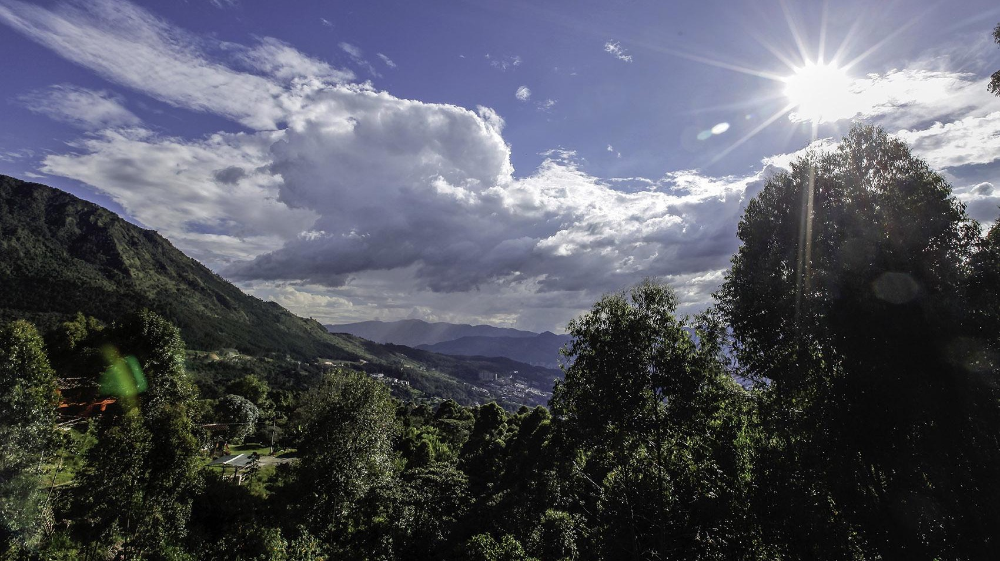
THANK YOU

Slide 17
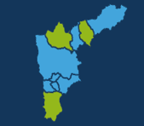
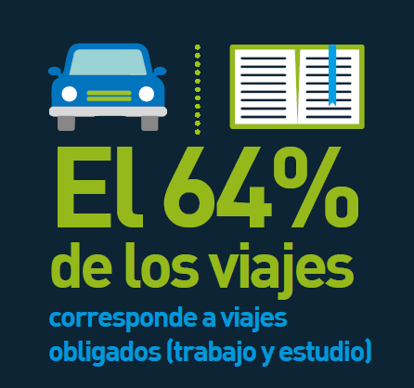
ORIGIN-DESTINATION SURVEY 2017
Travelers make up 74% of the population
Daily trips made in the Metropolitan Area
6’132.000
Active mobility trips
1’770.000
29%
Public transportation trips
2’780.000
45%
Private modes of transportation trips
1’582.000
26%

