Slide 1


Sustainable Mobility
Made in Leipzig
Leipzig, 16.10.2019
Dipl.-Ing. Torben Heinemann
City of Leipzig
Office for Traffic Planning and Road Construction

Slide 2
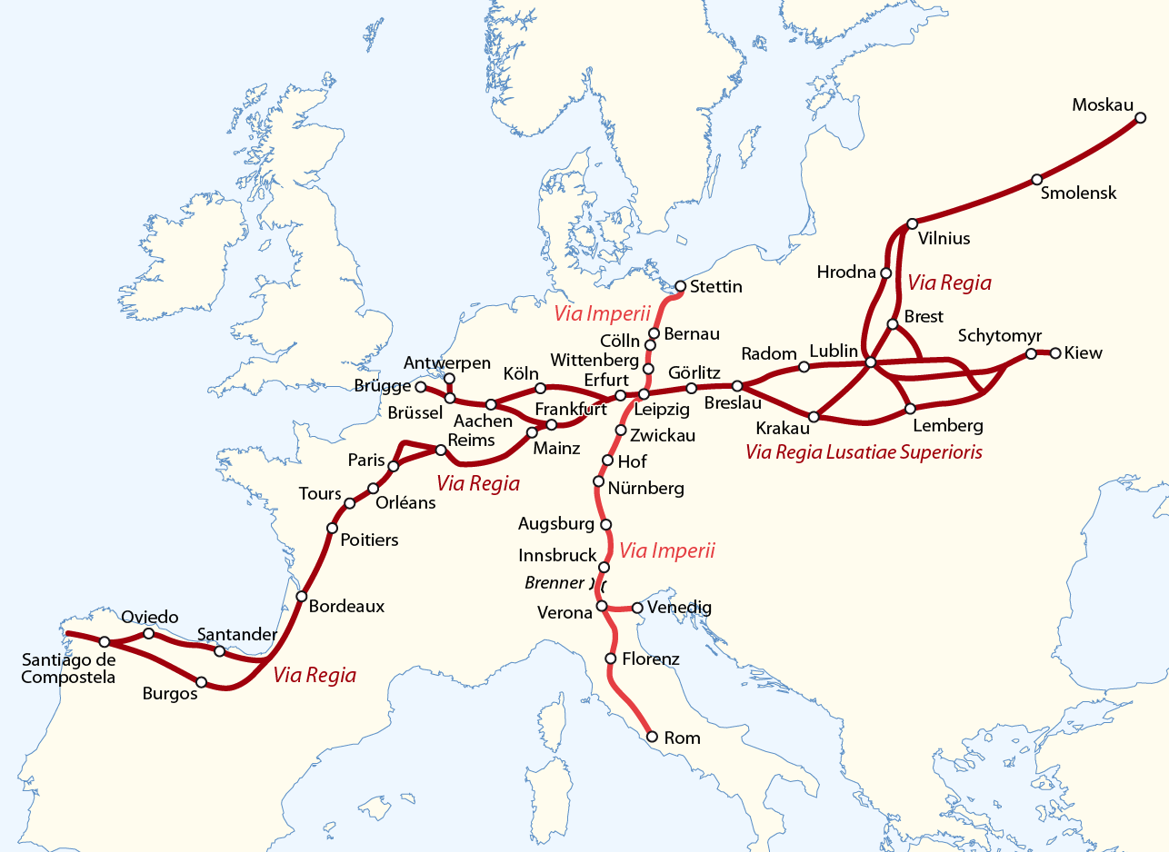
City of Leipzig, Germany
inhabitants 601.737
area 29.760 ha
road network 1.785 km
tram network 148 km
tram lines 13
bicycle network 505 km
via regia + via imperii =
1015 first time
documented as
„urbs libzi“
Office for Traffic Planning and Road Construction

Slide 3
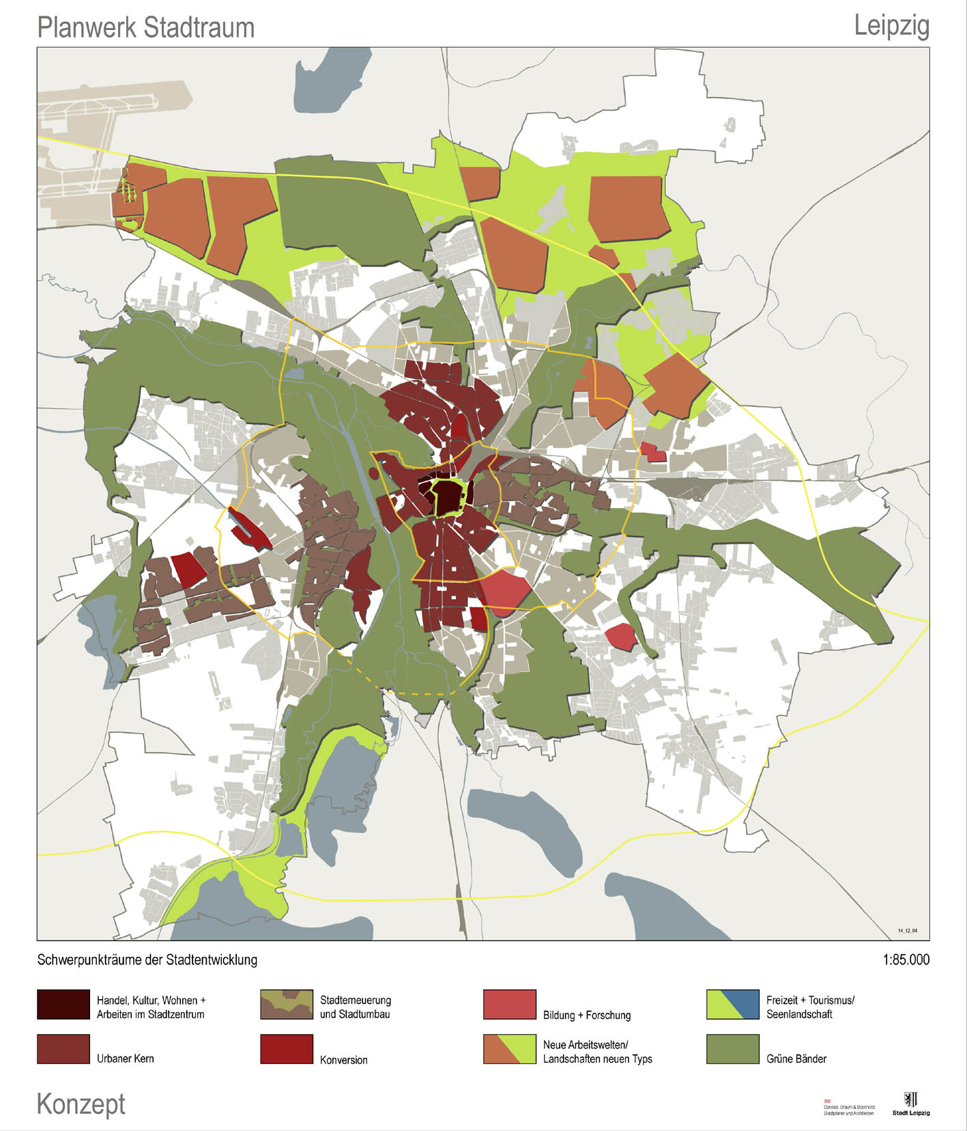

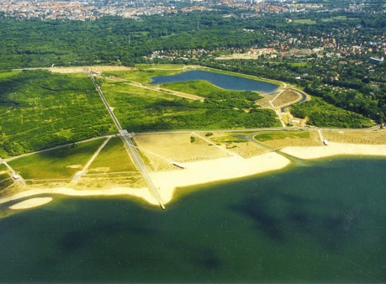
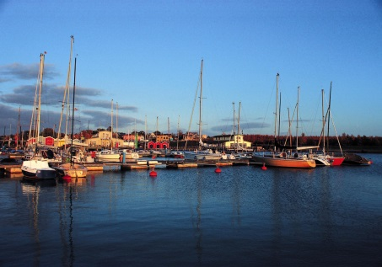
Leipzig city structure
North: New fields of employment
by foot
by bike
by pt
by car
South: Leipziger Neuseenland
SrV = Survey of travel behaviour every 5 years
Ziel 2015 = Goal for 2015 according to STEP 2003
Ziel 2025 = Goal for 2025 according to STEP 2015
Office for Traffic Planning and Road Construction
Notes:
Leipzig today is characterized by
new fields of employment in the north with the new trade fair, airport, BMW, Porsche and amazon
a historic and cultural centre
- Large green zones
and Leipzig New Lake Landscape, which arose out of former mining areas.

Slide 4
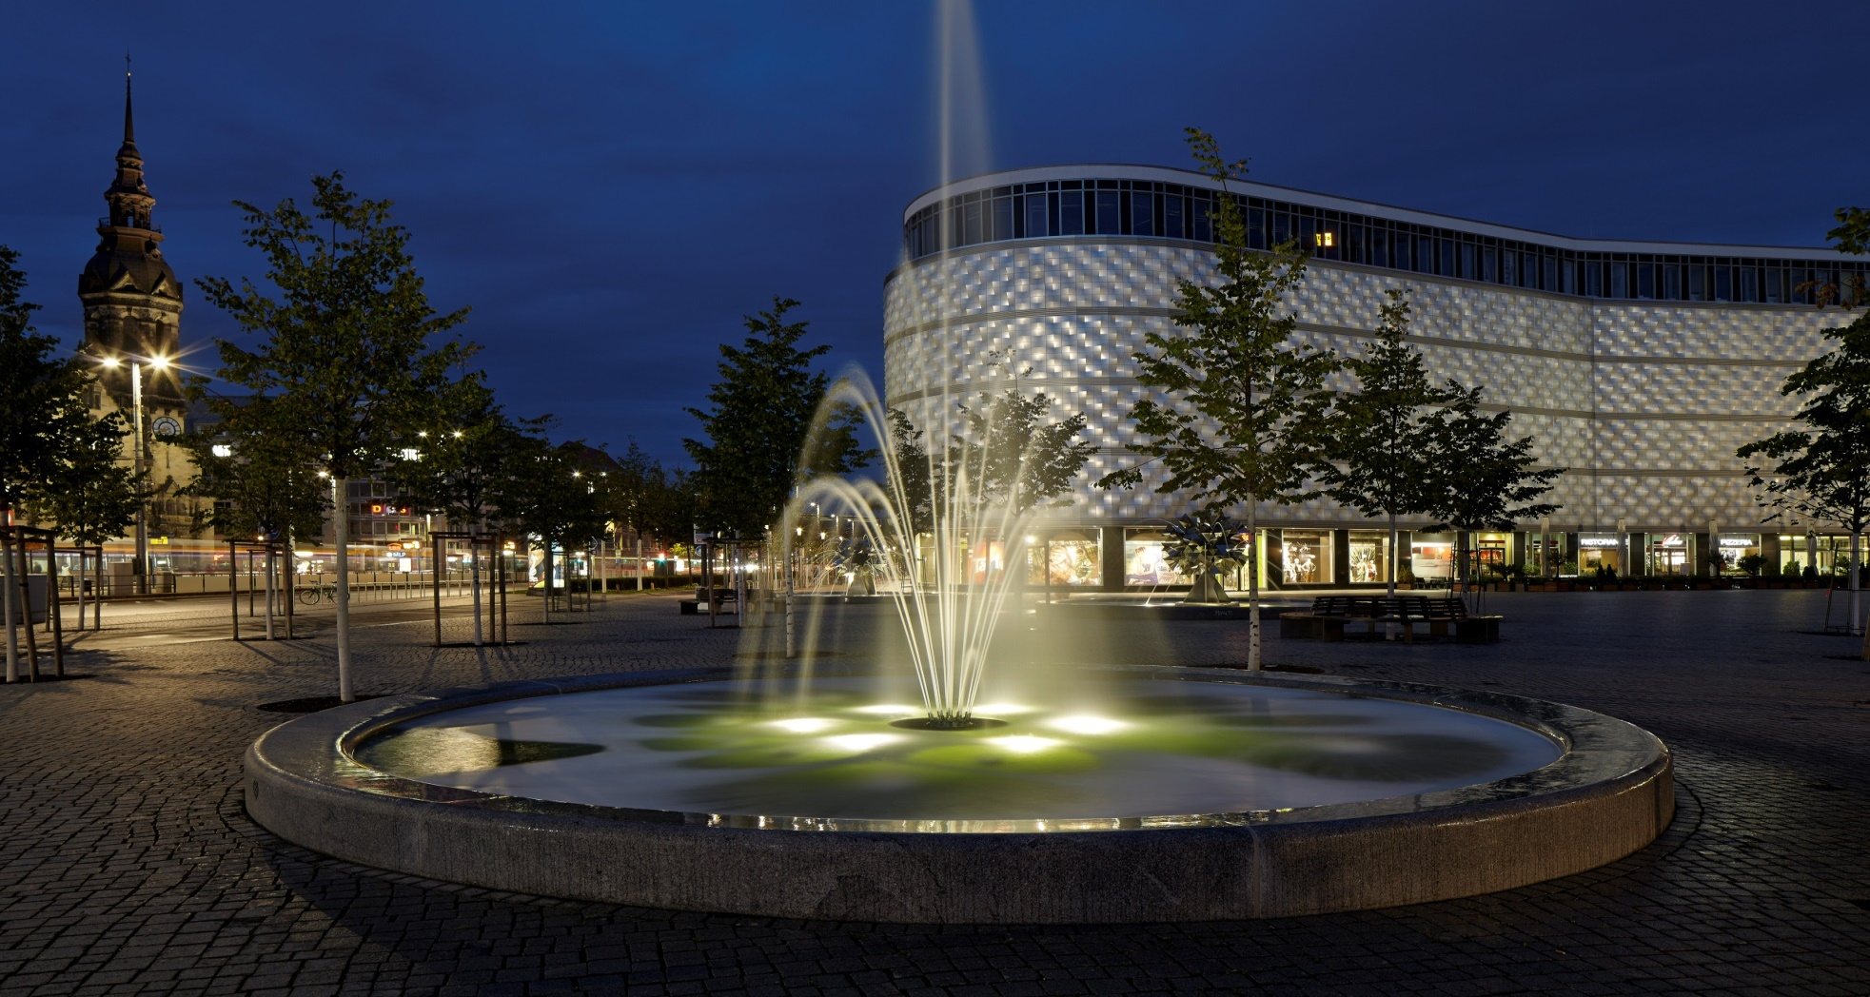
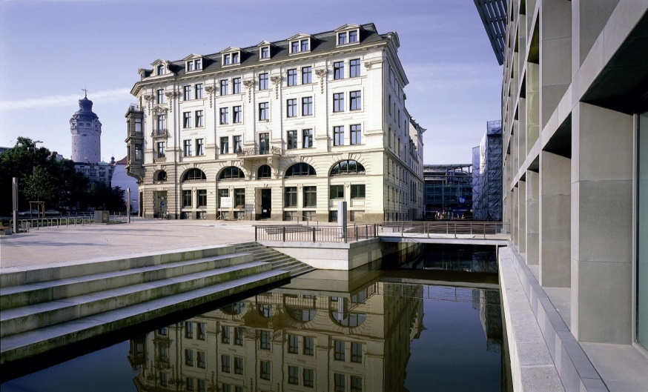
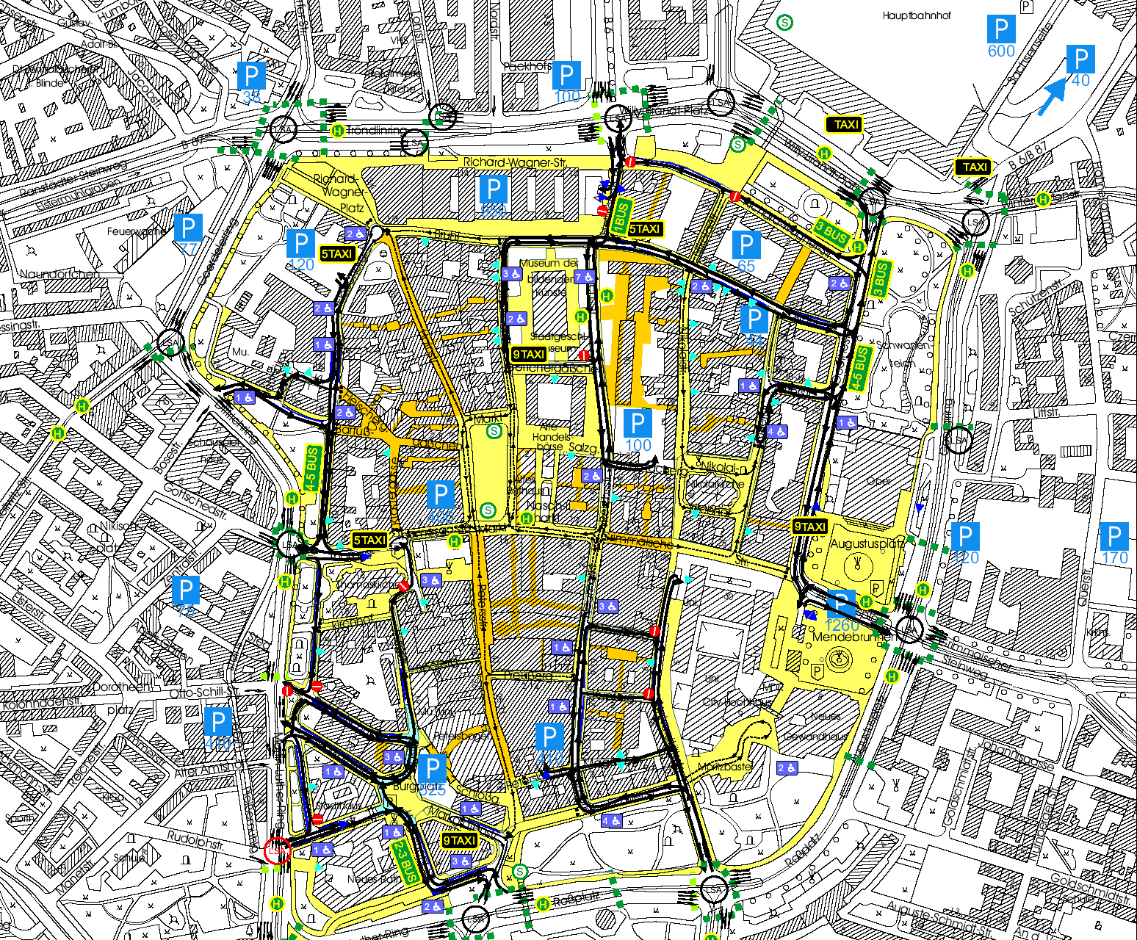
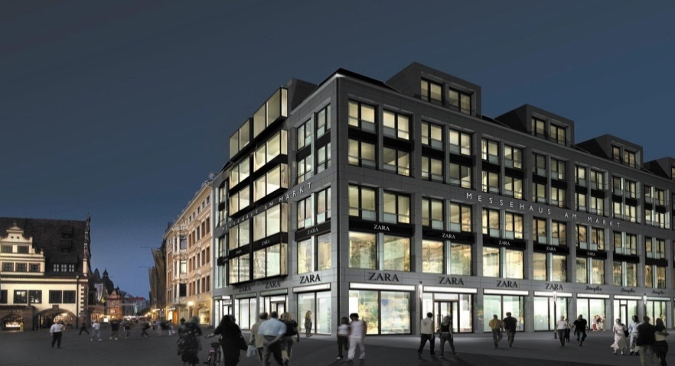
City centre – limited access for cars
Revitalizing public spaces: Richard-Wagner-Platz
a former parking lot for 120 cars
Office for Traffic Planning and Road Construction
4

Slide 5
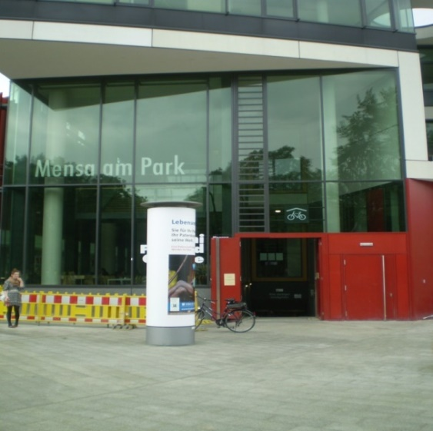
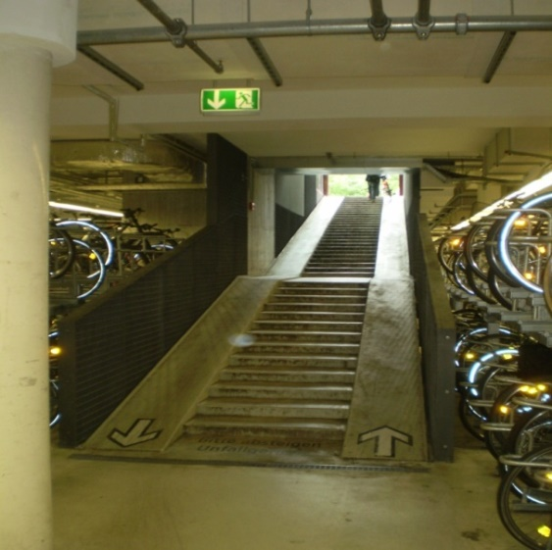
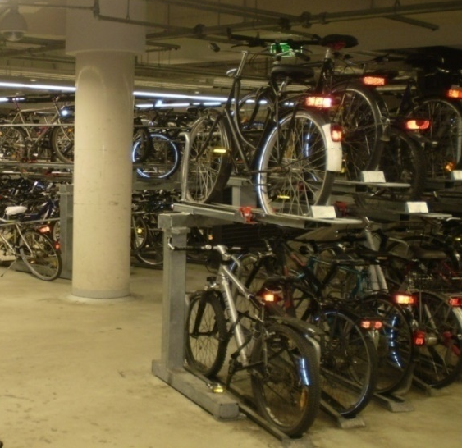
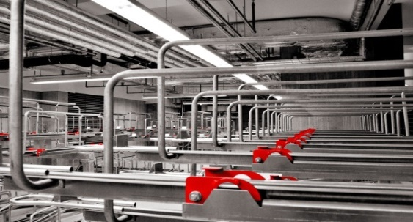
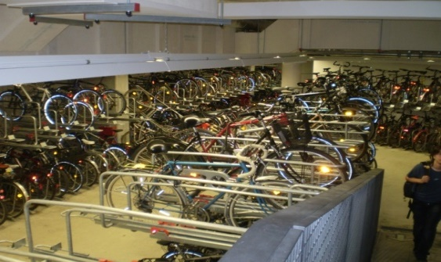
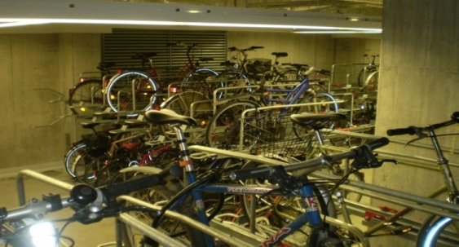
Best practice for bicycle infrastructure
bicycle underground parking at the university
Growth of trips by bike in Leipzig
from 1994 to 2015 by 520 %
Office for Traffic Planning and Road Construction
5
Notes:
5
erste Idee 1892 bei Vertrag zum Bau des Hauptbahnhofes und Erhalt Bayerischer Bahnhof
reichlich 100 Jahre bis zu Realisierung des Projektes
Bund, Freistaat Sachsen, Die Bahn, Stadt Leipzig: Rahmenfinanzierungsvereinbarung 18.03.2002
Finanzierungsvertrag, Projektvertrag, Kostenteilungsvertrag 23.05.2003
erster Rammschlag für CGV-Schacht am MdBK am 09.07.2003

Slide 6
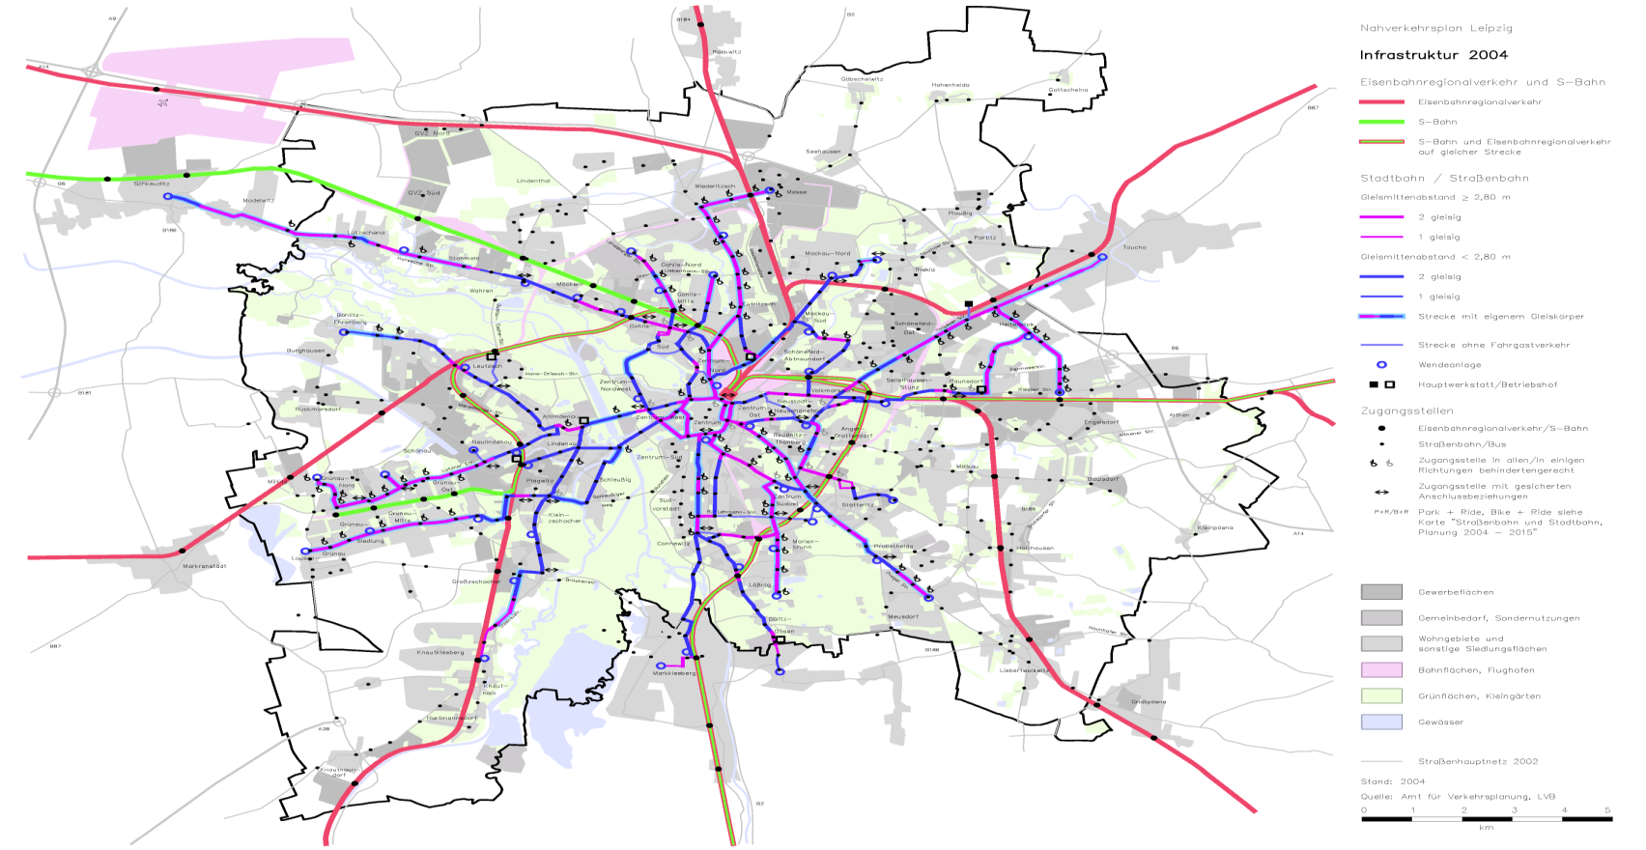
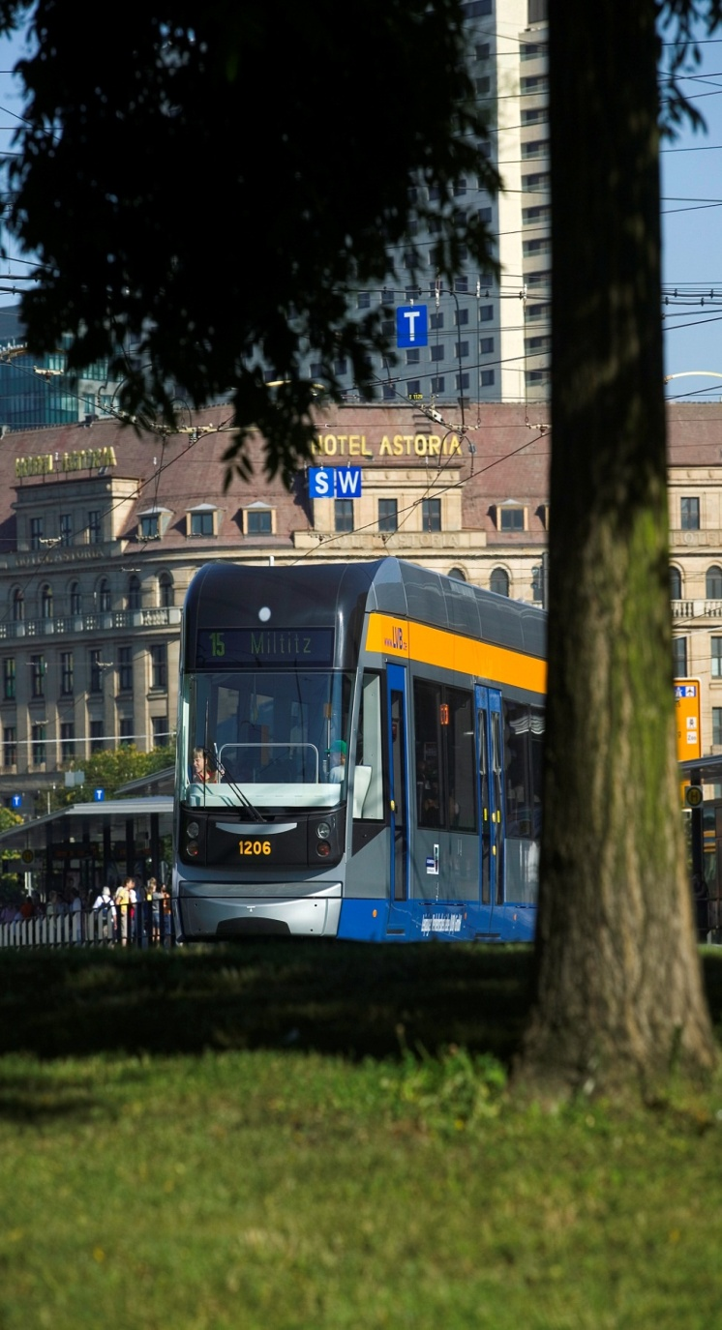
Modernizing the tram network
line 11
(1999 – 2025)
line 16
(1994 – 2005)
line 15
(1998 – 2016)
line 7
(2010 – 2020)
About 85 % of public transport in Leipzig is electric.
Office for Traffic Planning and Road Construction
6

Slide 7
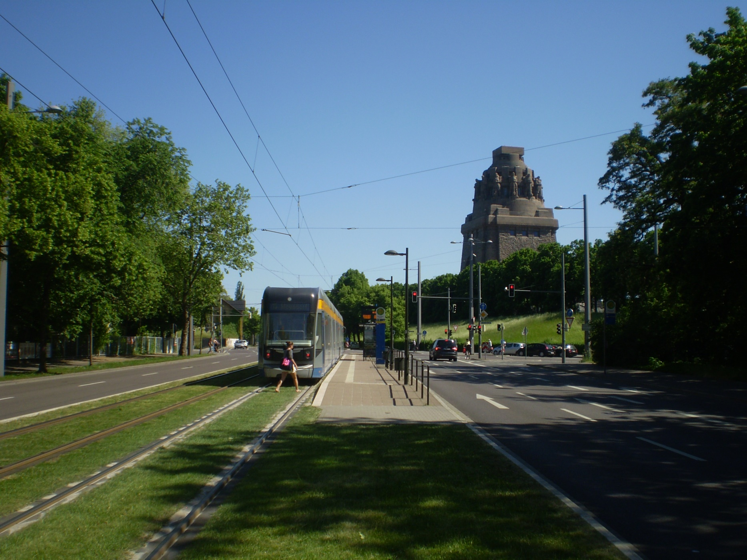

City of Leipzig
Department of City Development and Construction
Office for Transport Planning and Road Construction
04092 Leipzig
hone: +49 (341) 123 - 34 41
fax: +49 (341) 123 - 34 55
e-mail: Torben.Heinemann@Leipzig.de
www.Leipzig.de
7
7

