Slide 1
City of Boulder Colorado, USA Transforming Urban Mobility with Electric Vehicles
EcoMobility - Autonomy
October 16-17, 2019
Notes:
Name is …
Acknowledge team

Slide 2
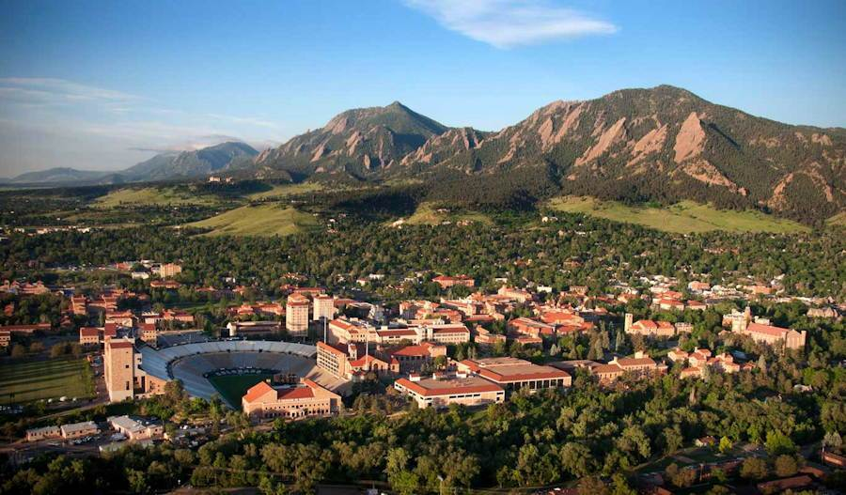
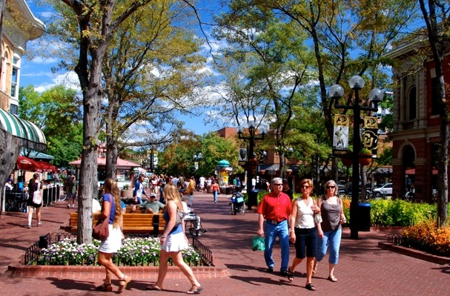
Boulder, Colorado
Eastern Foothills of the Rocky Mountains
70 sq. km
185 sq. km of Open Space
107,000 residents
104,000 jobs
University of Colorado and Federal Labs
Notes:
Alternate slides
27 square miles is 70 square kilometers
71 square miles is 185 square kilometers
Could eliminate the 40 res 60 non- res and just say that. Point is that most of the jobs are held by non-residents which leads to our in-commute challenges

Slide 3
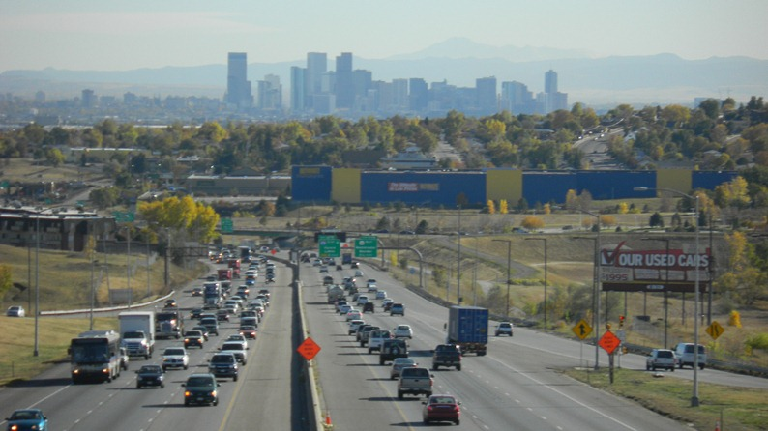
Colorado’s Climate Goals
Reduce GhG below 2005 levels:
26% by 2025
50% by 2030
90% by 2050
ZEV standard for auto dealers

Slide 5
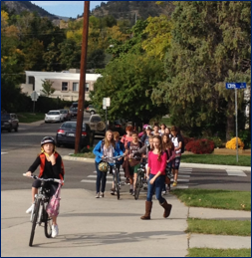
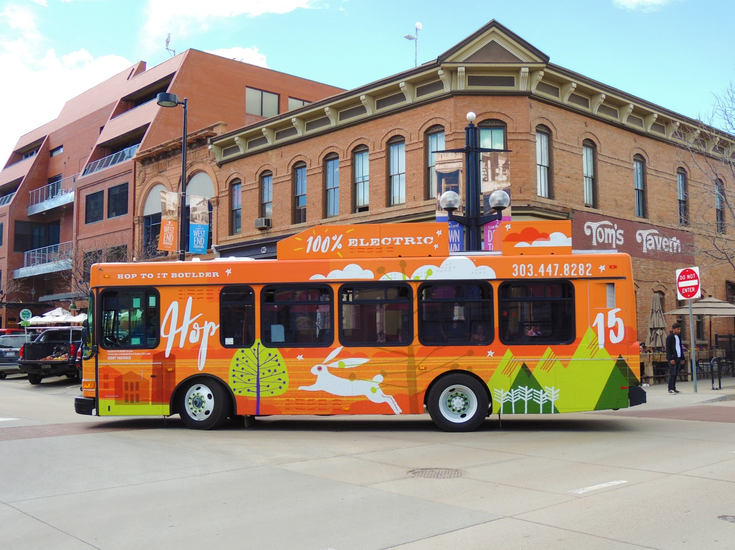
Climate Mobilization Action Plan
Declaration of Climate Crisis
28% of GHG emissions from ground transportation
Climate Plan aligned with Transportation Plan
Increase walk, bike, transit, micro-mobility options
Expand Electric Vehicles
Notes:
Kathleen, on this slide I would just add sub-bullets to the notes to reduce the words on the slide.
Boulder City Council adopted a resolution supporting the international climate crisis and committing to creating a new Climate Mobilization Action Plan that addresses many areas of focus, including energy and mobility
Boulder is leading at the local level and by adopting this declaration, the City of Boulder joins a global coalition of governments and leaders who officially acknowledge the existence of a global climate emergency and recognize the importance of local action to protect and enhance the well-being of current and future generations.
“Climate change has truly reached the level of being an emergency, and we need to move forward in taking action faster than ever, in a way that is broad-reaching, replicable and inclusive,” said Mayor Suzanne Jones. “Boulder has made great progress in working toward climate solutions, but this declaration will further add urgency to bringing the community together to mitigate and adapt to climate change.”
The resolution commits the city to climate mobilization action that immediately prioritizes efforts to safely draw down carbon from the atmosphere and accelerate adaptation and resilience strategies in preparation for intensifying climate impacts.
This comes on the heels of a renewed commitment to accelerating climate action through the city’s Climate Mobilization Action
Reduce GHG emissions
City 80% by 2030
Community 80% by 2050
100% Renewable Energy by 2030

Slide 6
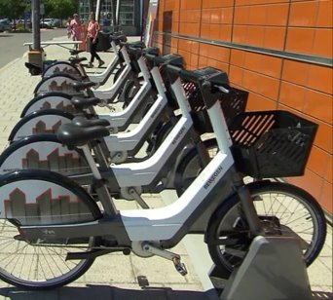
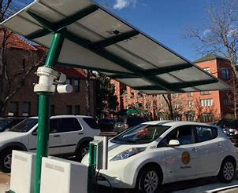
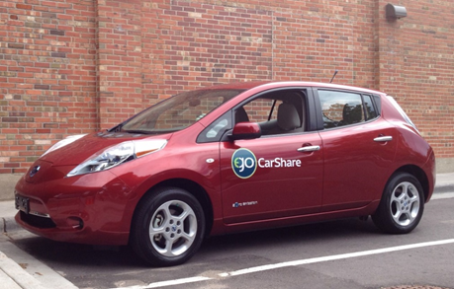
Promoting EVs in Boulder
Notes:
What is Boulder doing to promote more Evs?
Today in Boulder: 5% hybrid + 1% electric – goal is to grow #s and increase % of EVs
Currently 44 city-operated EV charging stations, with 8 more planned, at public parking locations throughout community.
Importance of charging infrastructure to support increased use of EVs.
City has requirements for multifamily housing developments to support EV charging
Transitioning city’s fleet of 16 HOP transit vehicles to EVs
Promoting walking, biking plus e-bikes and EV car share options

Slide 7
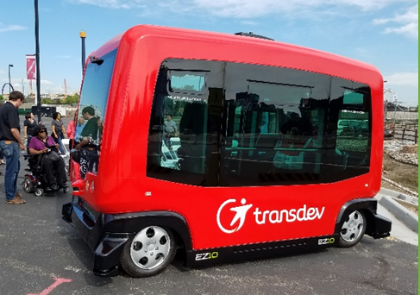
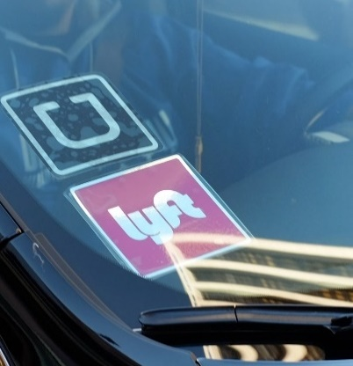
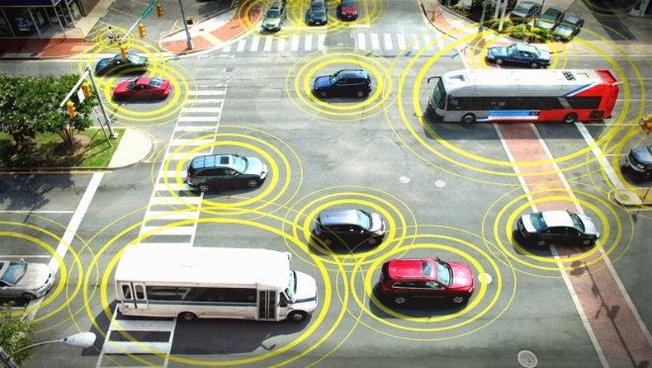
Boulder’s future of Advanced Mobility & Electric Vehicles
Safety
Managing public rights-of-way
Combination of shared, electric travel options
Support high quality, core transit service
Anticipate communication requirements
Support public private partnerships
Advocacy & Funding

Slide 8
Thank you - Merci Beaucoup
Mayor Suzanne Jones
JonesS@bouldercolorado.gov
Kathleen Bracke, GO Boulder Manager & Interim Co-Director of Public Works for Transportation
BrackeK@bouldercolorado.gov
Boulder Transportation Master Plan:
https://bouldercolorado.gov/transportation/tmp
Vision Zero:
https://bouldercolorado.gov/transportation/vision-zero
Climate Mobilization Action Plan:
https://bouldercolorado.gov/climate/cmap

