Slide 1
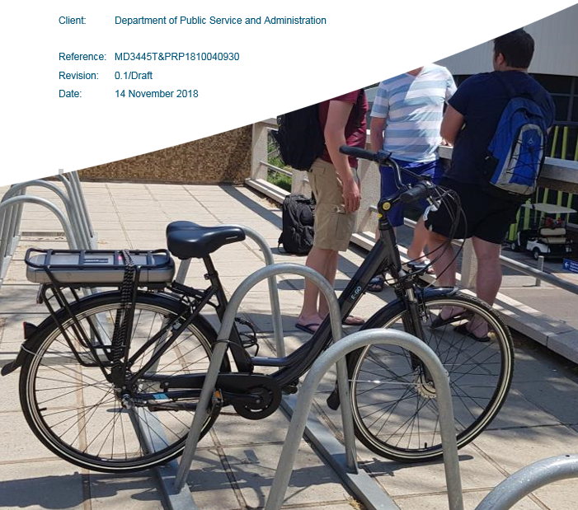

An experiment in a home-grown solution to Non-Motorised Transport problems
Christo Venter
University of Pretoria

Slide 2
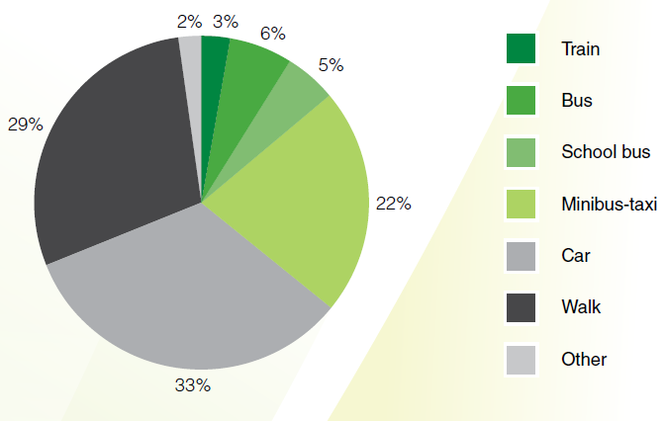
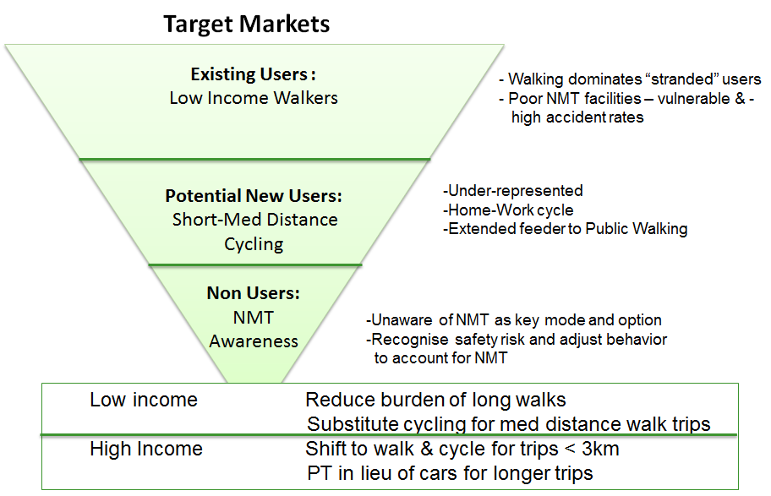
Non-motorised transport in the City of Tshwane
30% of trips are on foot
Cycling <1%
Draft NMT framework (2013): “cycling as a mode of choice”

Slide 3
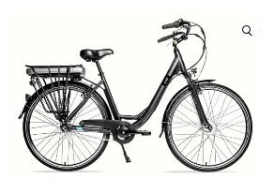
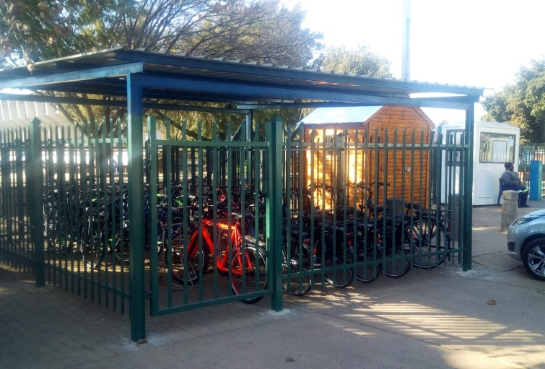
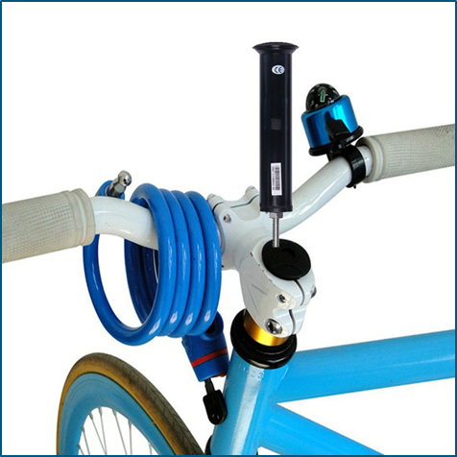
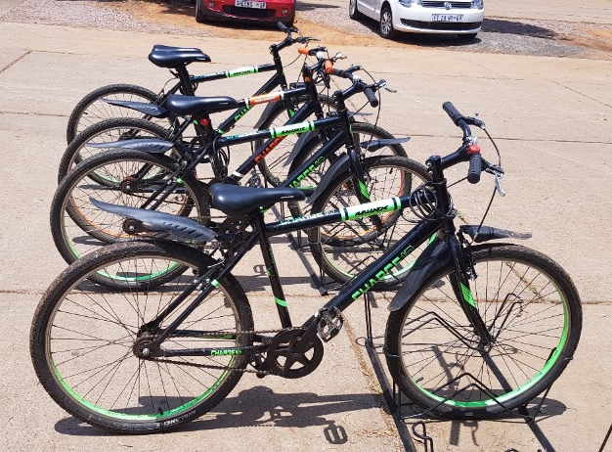
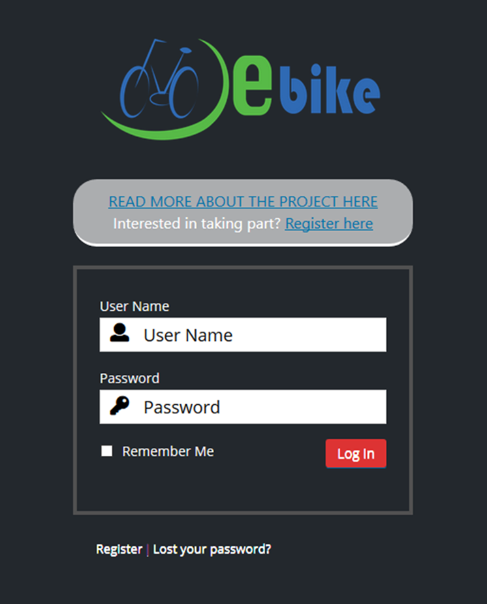
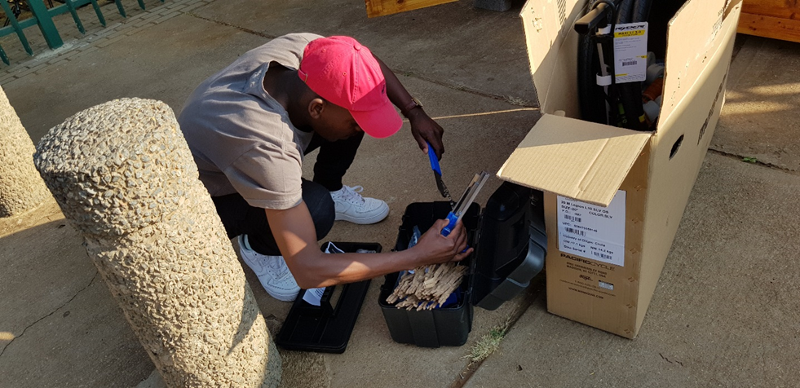
Project components
GPS tracking of bikes
10 manual bikes, 10 e-bikes
Kiosk for bike check-outs
and maintenance
Web-based booking system
Unemployed youth trained as staff

Slide 4
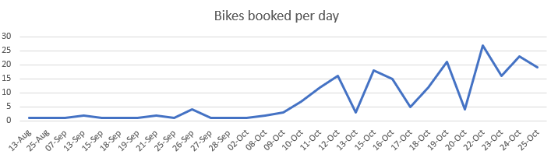
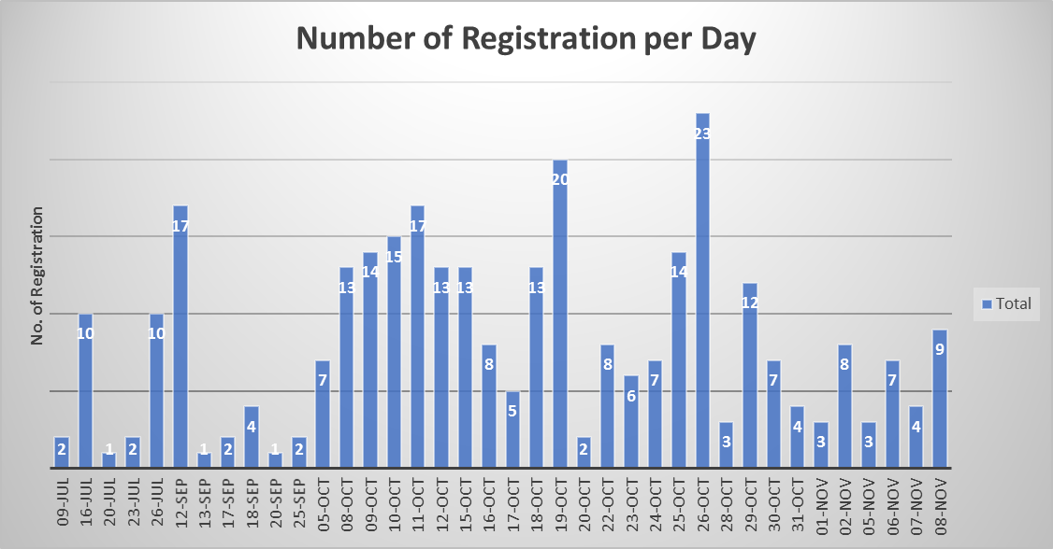
Did people use bikesharing?
Pilot duration Aug-Nov 2018
Registration and use spiked
after advertising and dropping
of fare to zero
Now 100% use of available bikes

Slide 5

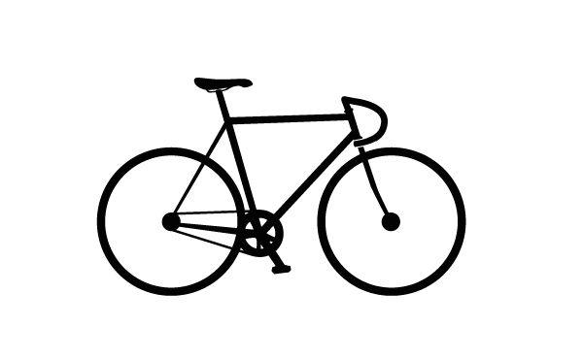
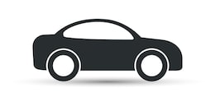
Who used bikesharing?
50%
13%
8%
Fit, young
Live close to campus
Mostly students
Fit, young(ish)
Mostly students
Older students, staff
Various home locations

Slide 6
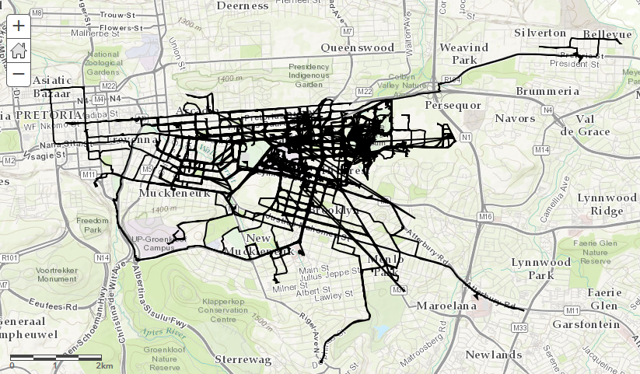
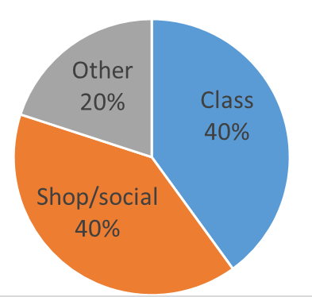
How did people use bikesharing?
MAIN
CAMPUS
2KM
4KM

Slide 7
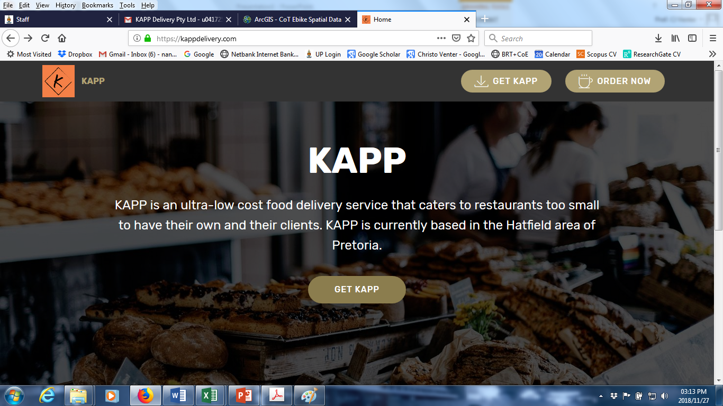
How did people use bikesharing?
Youth
entrepreneurship

Slide 8
Who is attracted to bikesharing?

Slide 9
Lessons learnt
Homegrown experimentation allows for local learning and adaptation, lowers implementation risk
Allow time for tweaking it
There is huge demand for bicycling, especially among young people currently walking
Effective marketing and bike maintenance = largest challenges
Think about bicycling as enabler of youth entrepreneurship

