Slide 1
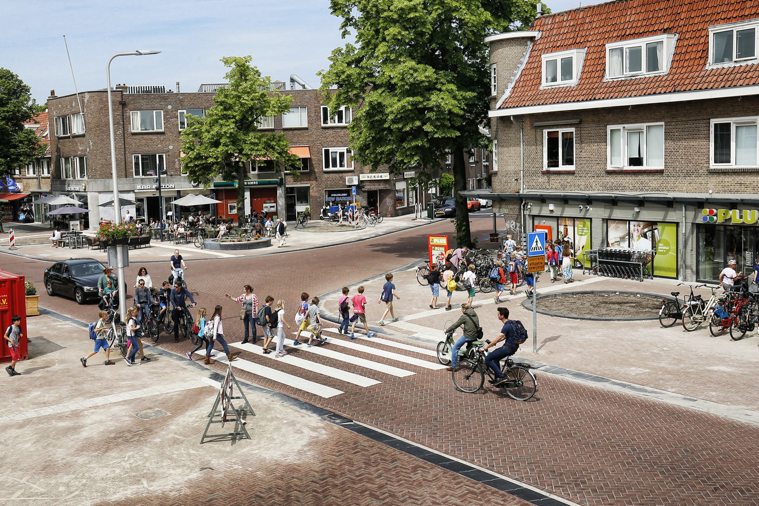


Sustainable Urban Mobility
ICLEI — Local Governments for Sustainability
ICLEI World Secretariat
28 November 2018

Slide 2
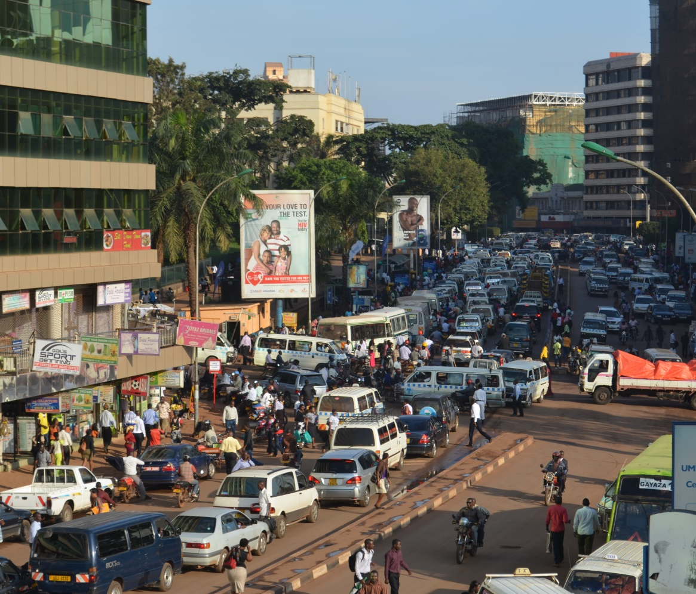
Why Sustainable Urban Mobility?
US$800m (over sh2.8trillion) in lost Gross Domestic Product (GDP) due to traffic congestion in Uganda
(WB 2009).
Notes:
A World Bank study says those traffic jams are costing Uganda over US$800m (over sh2.8trillion) in lost Gross Domestic Product (GDP).
What would the sh2.8trillion do? It is equivalent to the combined budgets for the ministries of HEALTH at sh1.2 trillion, AGRICULTURE at sh863b and ICT at sh300b, plus a well-equipped secondary school from senior one to senior six, complete with laboratories at sh600m, and probably a primary school at sh400m. Alternatively one could construct 4660 well equipped secondary schools.
Economies rely on the flow of goods and the mobility of people. If urban mobility is stuck in traffic so is economic development.

Slide 3

Why Sustainable Urban Mobility?
Notes:
In South Africa, Cape Town is rated as most congested city, ranking 41st globally, down from 33rd in the previous year’s ranking. Johannesburg is second, and also IMPROVED its ranking to 55th, from 44th on the global list.
Commuters in Cape Town spend, on average, 49 hours in peak traffic, while those drivers in Joburg spend 46 hours, with Durban, Pretoria and Pietermaritzburg making up the top five worst cities.

Slide 4
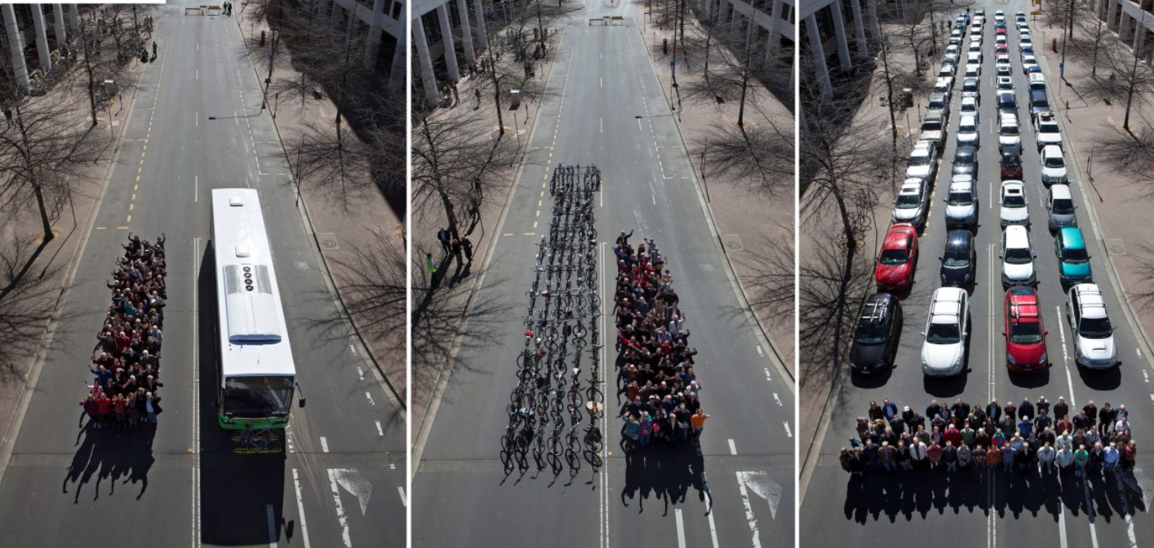
4
Photo: Cycling Promotion Fund (2015)
Notes:
‘Waste of space’, latest creation in Canberra, Australia
In the space it takes to accommodate 60 cars, cities can accommodate around 16 buses or more than 600 bikes.
In order to move people more efficiently and effectively, we need to get smarter about how we use existing road space — including investing more in alternatives such as public transport and cycling.

Slide 5
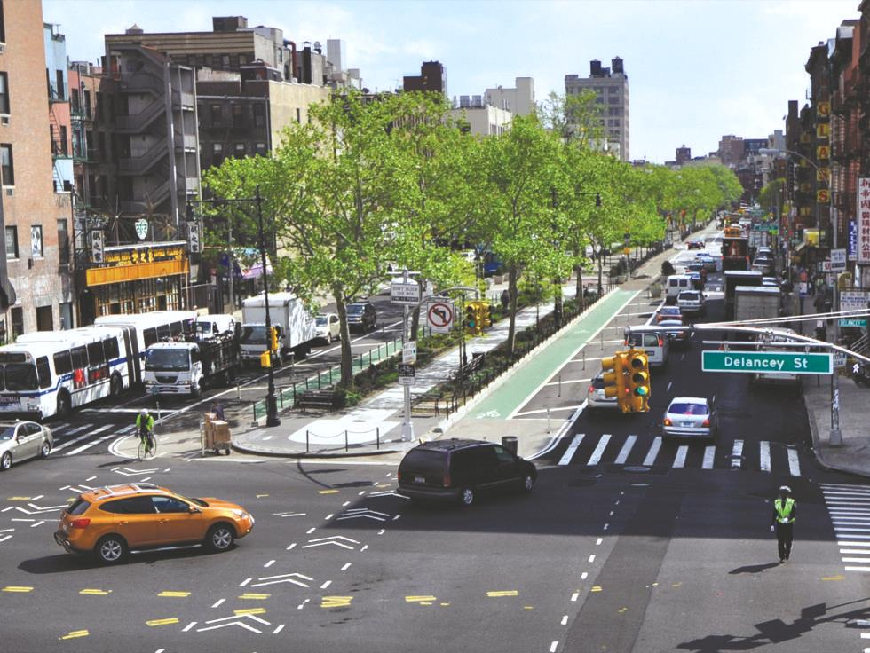
People-centred urban development
Better use of urban space
Health
Safety
Economic benefits
Time saving
Equitable access
Low emissions
Photo: www.nacto.org
Notes:
Sustainable transport strategies can have an extensive overall impact on sustainable urban development.
- Public health benefits result from more active transport (cycling and walking).
Road safety is also a major transport policy objective that SUM strategies can help achieve.
Employment and economic impacts relate to a number of direct and indirect effects of sustainable transport, such as direct employment opportunities.
Air quality is another major issue to which low-carbon transport can make a positive contribution by reducing vehicle emissions.

Slide 6
The Vision for Cities
SDG 11.2.: By 2030, provide access to safe, affordable, accessible and sustainable transport systems for all, improving road safety, notably by expanding public transport, with special attention to the needs of those in vulnerable situations, women, children, persons with disabilities and older persons
What is the need and vision for your city?
Who has the right of way?
What can we use to fulfill the needs?

Slide 7

What is EcoMobility?
Cycling/
Wheeling
Public Transportation
Light electric vehicles
Walking
Sharing
Integrated and connected manner
Notes:
EcoMobility gives priority to walking, cycling, public transport, shared and light electric vehicles. It promotes travel through integrated, socially inclusive, and environmentally-friendly transport options without depending on privately owned vehicles.
EcoMobility indicates a new approach to mobility that highlights the importance of public and non-motorized transport and promotes an integrated use of all modes in a city.
Incorporating EcoMobility into the development of traffic systems and policies will benefit local governments in attaining international recognition for the city and its leadership.

Slide 8

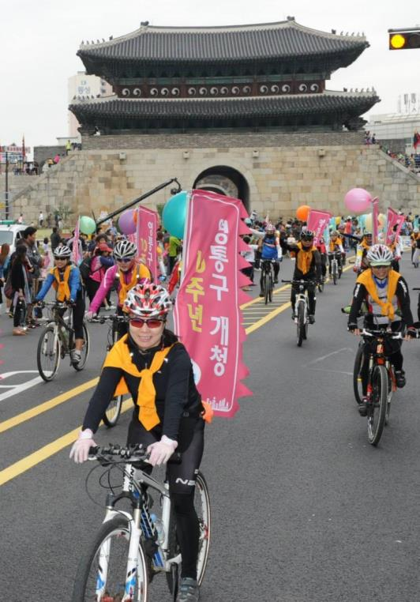
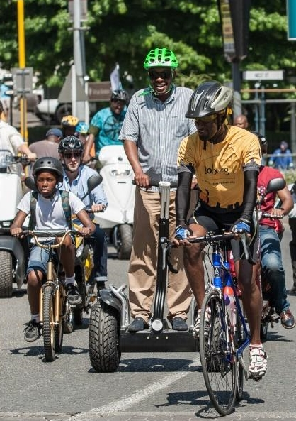
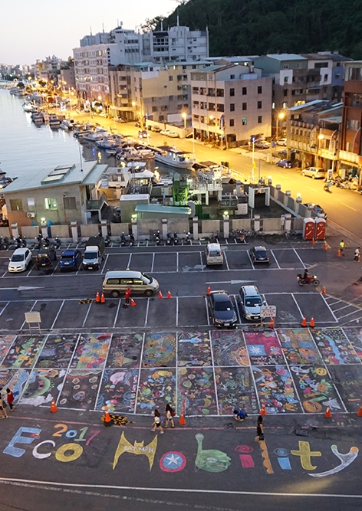
EcoMobility World Festival and Congress
2013
2015
2017
Suwon
South Korea
Johannesburg
South Africa
Kaohsiung
  www.ecomobilityfestival. org

Slide 9
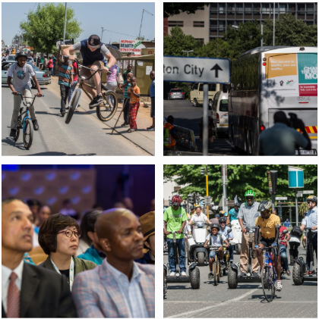
EcoMobility World Festival 2015
Change the way you move!
Joburg
South Africa

Slide 10
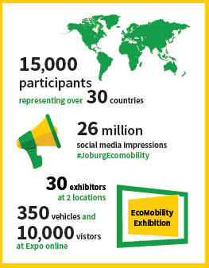
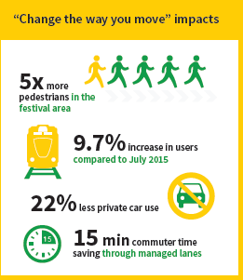
EcoMobility World Festival 2015
Change the way you move!
Joburg
South Africa

Slide 11
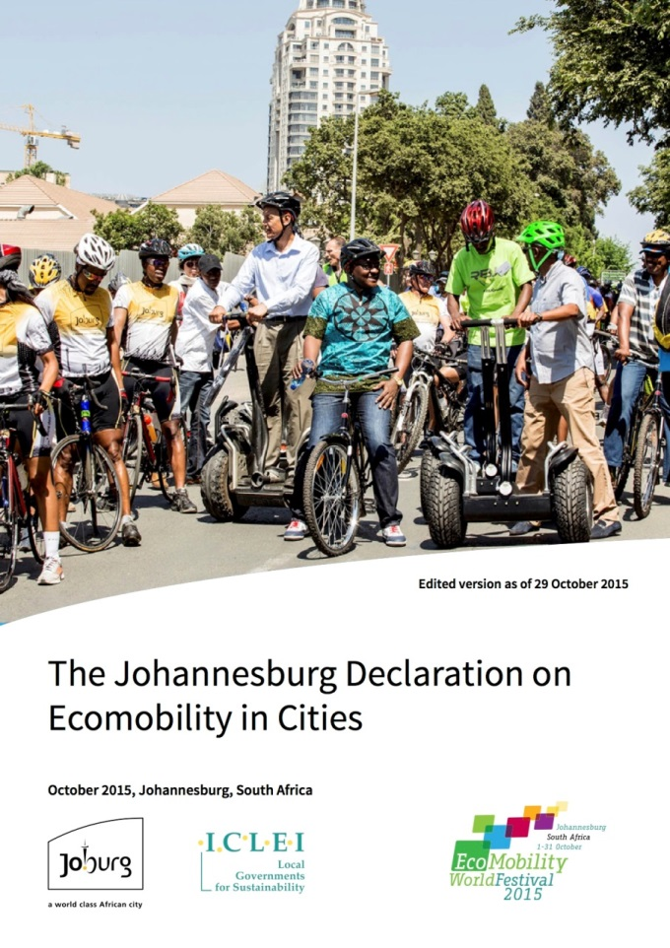
Joburg Declaration on Ecomobility in Cities, 2015
Recognise “Ecomobility” and its benefits in reduction in GHG emissions
Create streets for people
Implement immediate low cost measures; and develop long-term financially sound ecomobility solutions
Phase out incentives encouraging private motorized vehicles
Introduce concepts of new and shared mobility (including car sharing, carpooling and bike sharing ).
Switch to low carbon energy vehicles, small (human-scale) light electric vehicles.

Slide 12
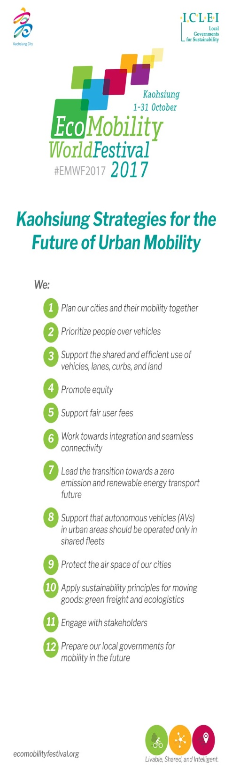
The Kaohsiung Strategies for the Future of Urban Mobility, 2017
Plan your city and mobility together.
Prioritize people over vehicles.
Support the shared and efficient use of vehicles, lanes, curbs, and land.
Promote Equity.
Support fair user fees.
Work towards integration and seamless connectivity.
Lead the transition towards a zero emission and renewable energy transport future.
Support autonomous vehicles (AVs) in urban areas that are operated only in shared fleets.
Protect the air space of your city.
Apply sustainability principles for moving goods: Green freight and ecologistics.

Slide 13
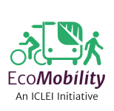






ICLEI Global: How do we help cities?
Action areas
Setting priorities and supporting actions for improvements
Accessing finance
Providing knowledge
Evaluating current situation
Examples of initiatives & projects
Reducing dependency on private motorised vehicles
Sustainable Urban Mobility Plans (SUMP)
Green vehicles procurement
Mobility assessment and audits
Information repository
Sustainable mobility campaigns
Facilitating innovative urban transport solutions
EcoMobility World Festival & Congress
TUMI Network
EcoMobility Alliance
SMART SPP
EcoMobility SHIFT
CIVITAS
Eltis
Notes:
SMART SPP
innovation through sustainable procurement was a European project which promoted the introduction of new, innovative low carbon emission technologies and integrated solutions onto the European market. SMART SPP strongly focuses on implementation and therefore five public authorities in the United Kingdom, Denmark, Spain and Portugal
- Lighting systems (LED indoor and outdoor (street) lighting),
- Electric vehicles systems (charging points and cars), and
- Vending machine
CIVITAS 2020 - European Union's CIVITAS 2020 Initiative.
CIVITAS is a network of cities for cities dedicated to cleaner, better transport in Europe and beyond. Since it was launched by the European Commission in 2002, the CIVITAS Initiative has tested and implemented over 800 measures and urban transport solutions as part of demonstration projects in more than 80 Living Lab cities Europe-wide.
Eltis
facilitates the exchange of information, knowledge and experiences in the field of sustainable urban mobility in Europe. Created more than 10 years ago, Eltis is now Europe's main observatory on urban mobility.

Slide 14






Connect with us!
  www.ecomobility.org
  ecomobility_
  ecomobility@iclei.org
@ICLEI
ICLEI Global
www.iclei.org
www.talkofthecities.iclei.org

