Slide 1
CITY OF TSHWANE – A RE YENG
LESSONS LEARNT: MINIBUS TAXI INDUSTRY

Slide 2
CONTENTS
Background
Representative Structures
TRT (Pty) Ltd
MOA Engagement Structures
Ecomobility within the Minibus Taxi Industry
Challenges
Strengths
Capacitation of Minubus Taxi Indutry
Industry Transition Compensation Negotiations
Implementation of Agreements

Slide 3
BACKGROUND – Representative Structures
REPRESENTATIVE STRUCTURES

Slide 4
BACKGROUND – TRT (Pty) Ltd
TRT (Pty) Ltd Board

Slide 5
MOA ENGAGEMENT STRUCTURES
TIPMU SC
PMU
TITA
JSC
COT
Taxi Industry Leadership
Superstructure
City Manager
Chairpersons of GTRTC and TOPIC
Mandate – Technical/ Recommendation
Mandate – Decision Making

Slide 6
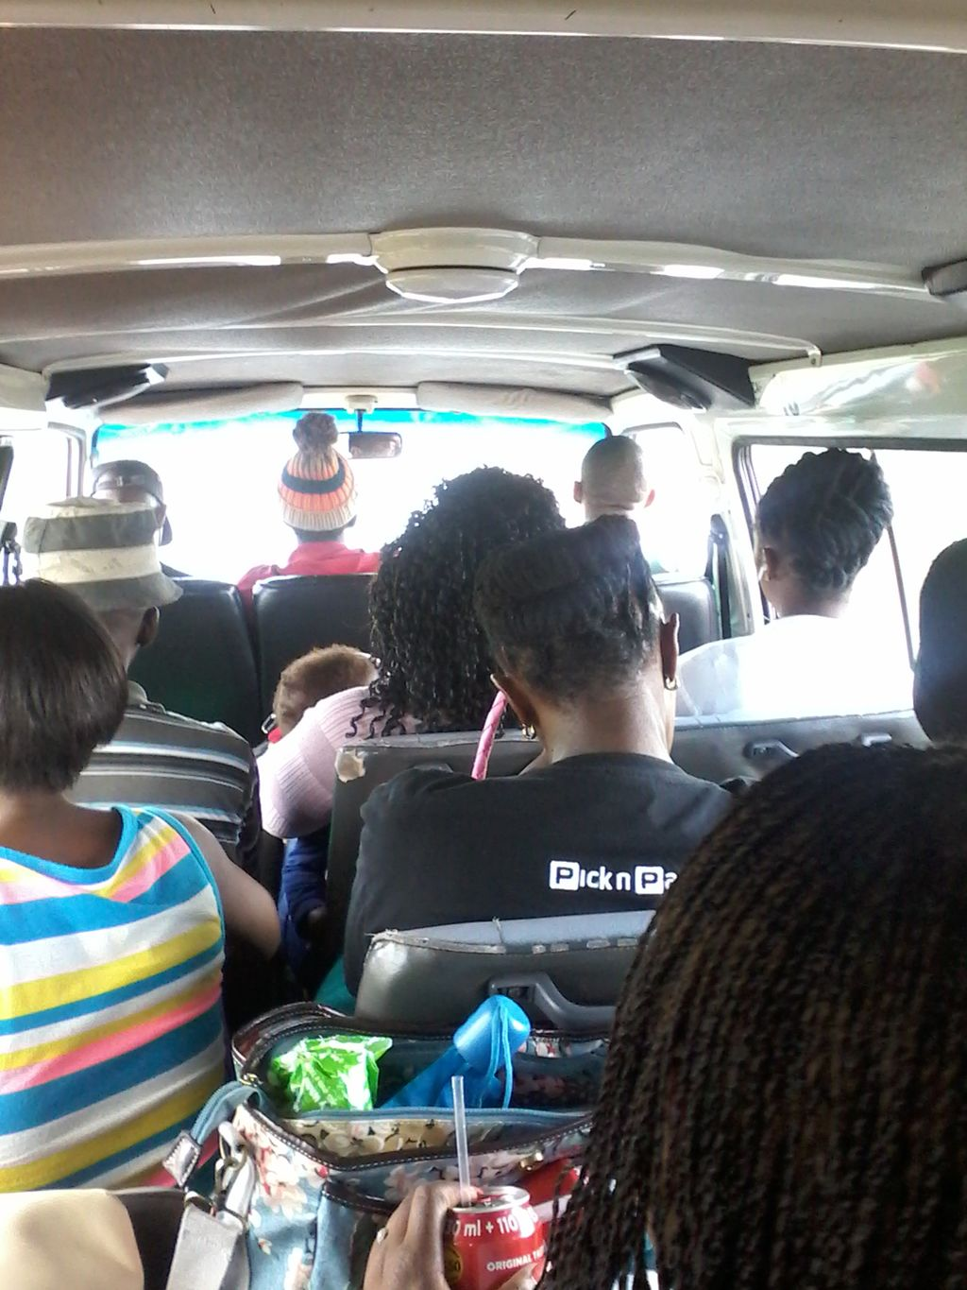
PATRONAGE WITHIN THE TAXI INDUSTRY
Challenges:

Slide 7
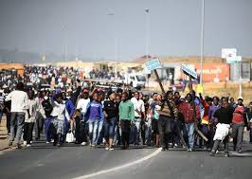
RESISTANCE BY COMMUTERS
Challenges: Resistance by commuters to transfer at Wonderboom Transfer Facility

Slide 8
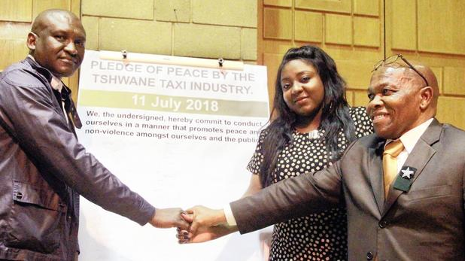
STRENGTHS - UNITY WITHIN TSHWANE TAXI INDUSTRY

Slide 9
CAPACITATION OF MINIBUS TAXI INDUSTRY
Complex negotiations
Technical Advisors appointed to capacitate Taxi Industry during negotiations
Compensation Strategy was developed and agreed with Industry
The Full Clearance Permanent Compensation Strategy adopted
Negotiations conducted in line with the implementation phases

Slide 10
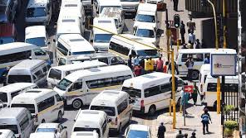
CONCEPT OF FULL CLEARANCE OF MINIBUS TAXIS

Slide 11
COMPENSATION FOR AFFECTED MINIBUS TAXIS
COMPENSATION PACKAGE
Component A:
Once-off Permanent Compensation Amount
Component B:
Monthly Compensation Installments
Component C:
Integrated A Re Yeng and Taxi Fare Dispensation

Slide 12
CONCLUSION
The Minibus taxi industry is fully committed towards ecomobility and sustainable transport
The transformation of the Minibus Taxi Industry is very critical in achieving a sustainable transport system
There are high costs involved in the transformation of the Minibus Taxi Industry due to their historical background
This requires commitment at all the key stakeholders – Government and the entire public transport industry

